Slide 1
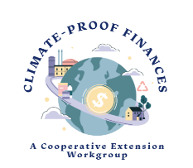
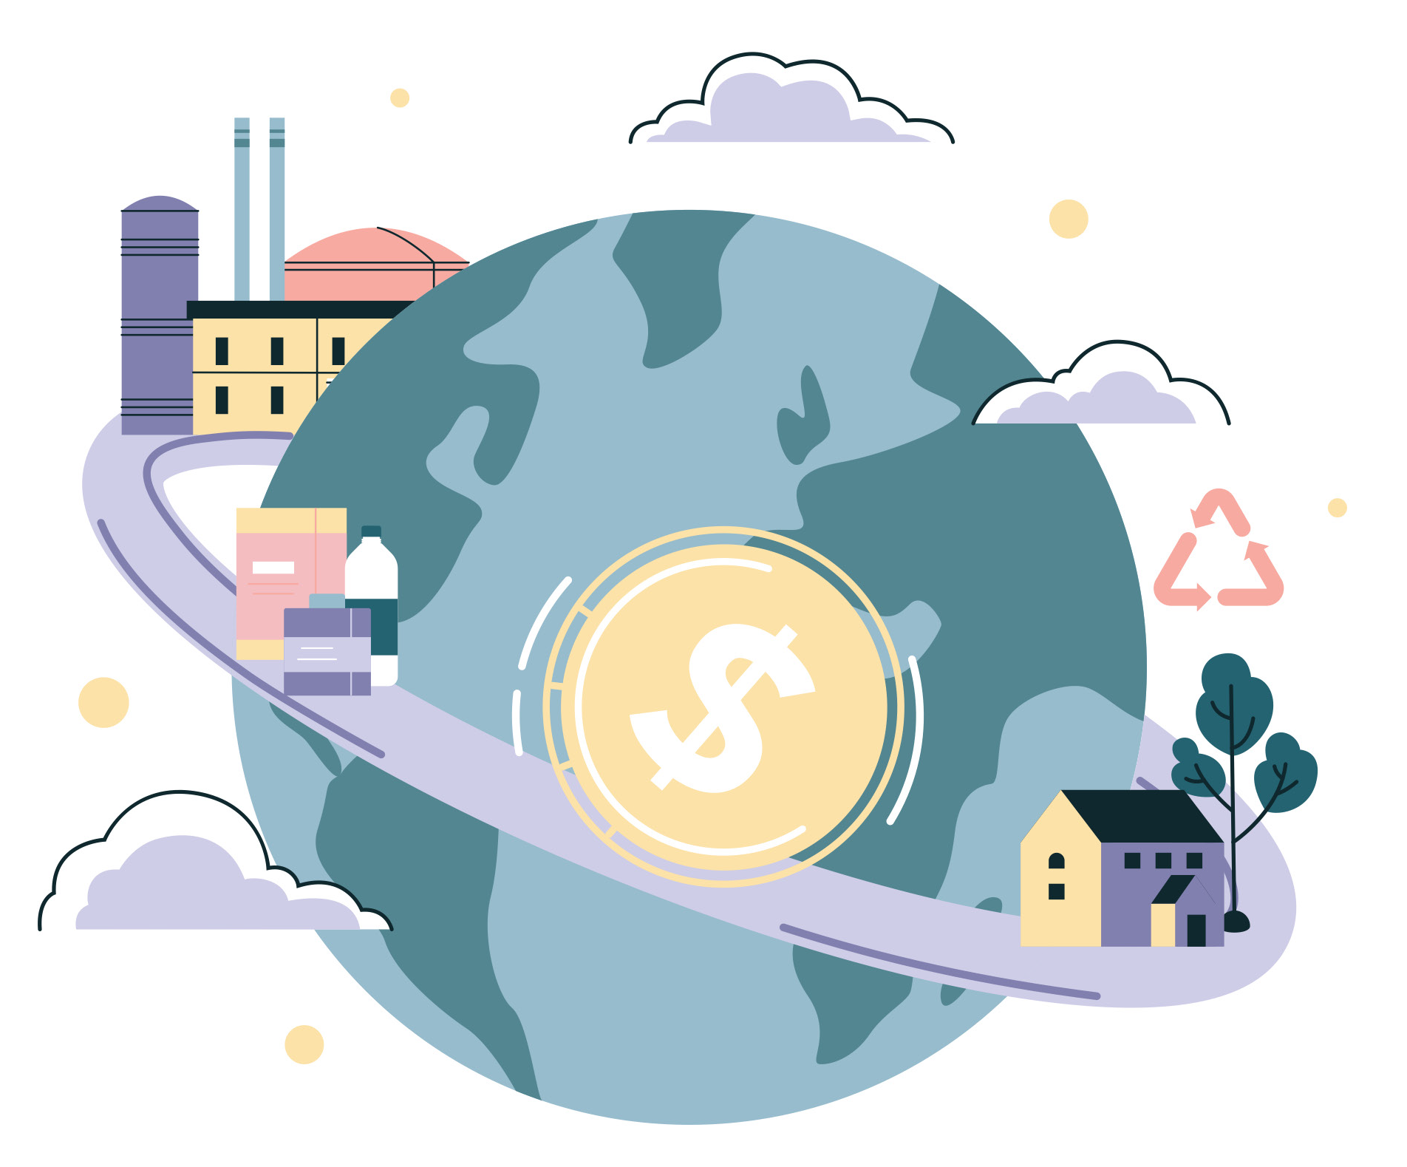
52 Ways To Climate-Proof Your Finances
(30 minutes)
INSERT SPEAKER NAME INSERT ORGANIZATION
Notes:
DO: Welcome the group. Conduct any housekeeping items or make any announcements needed.
SAY: Share that this program and resource was developed by a group of Extension faculty/educators from 10 Universities who are part of the Financial Security for All Community of Practice and the Climate Change Impacts on Family Resoruce management (CCI FRM) sub-group. (The list of contributors will be shared at the end of the ppt)
Feel free to add your Extension service logo in the upper lefthand corner

Slide 2
Objectives
As a result of this lesson, the participant will be able to…
Understand how climate change can aﬀect personal ﬁnances.
Identify action steps to climate-proof ﬁnancial aﬀairs.
Create a personal action plan that outlines action steps, encourages prioritization, and documents completion of speciﬁc tasks.
Notes:
SAY: We are excited to have you with us today for our program on 52 ways to climate proof your finances.
DO: Introduce yourself and your organization.
SAY: During our time together there are three objectives I want us to accomplish. At the end of this presentation, you'll be able to understand how climate change impacts personal finances. But more than that, you'll be able to identify action steps to climate proof your own personal finances. Finally, we will work together to create a personal action plan. This action plan is going to outline action steps and documents needed to complete specific task in the publication we will be using today.

Slide 3
Climate Change- What We Know
Climate change consequences are substantial and escalating (U.S. Department of the Treasury, 2023)
Increased severity, extent, and frequency (USGCRP, 2023)
Families are vulnerable (U.S. Department of the Treasury, 2023)
Now is time for action (U.S. Department of the Treasury, 2023)
Notes:
SAY: Whether you use the term "climate change", "climate emergency", "changing weather patterns", or others, the changes were are seeing in our climate today are substantial and escalating. These changes are due in part to the increased frequency and severity of weather events, rising sea levels, and higher temperatures (U.S. Department of the Treasury, 2023).
The Fifth National Climate Assessment (USGCRP, 2023) reports an increase in the severity, extent, and frequency of multiple types of extreme events including heat waves, droughts, large rainfalls causing flood risks, hurricanes, and wildfires.
American families are increasingly vulnerable to climate-related risks, which have cascading effects on household finances. The US Department of Treasury has encouraged families to enhance their financial well-being or resilience by taking action now.

Slide 4
Think About It
What types of climate related events have occurred (or could potentially occur) in your community?
How have/could these climate events aﬀect your personal ﬁnancial situation or the ﬁnancial situations of those in your community?
What are some actions that could be taken to protect your ﬁnances if a similar climate event where to occur again in the future?
Notes:
DO: Lead the group in a brainstorming activity using the three questions above as a guide. Allow time for discussion

Slide 5
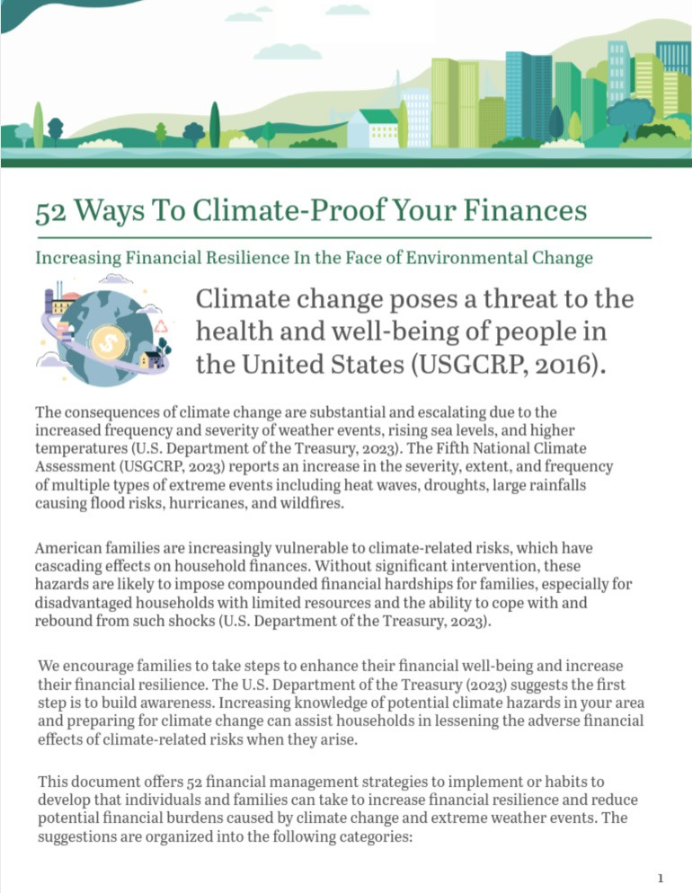
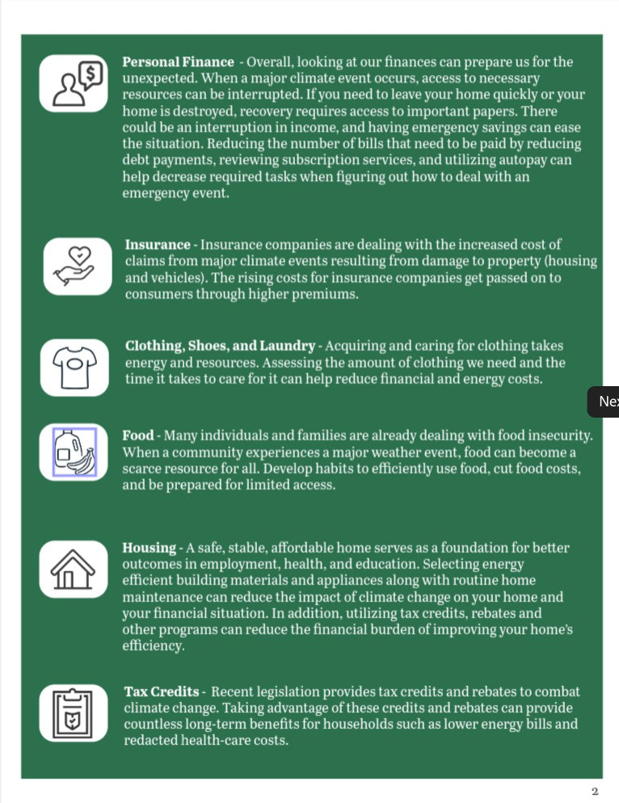
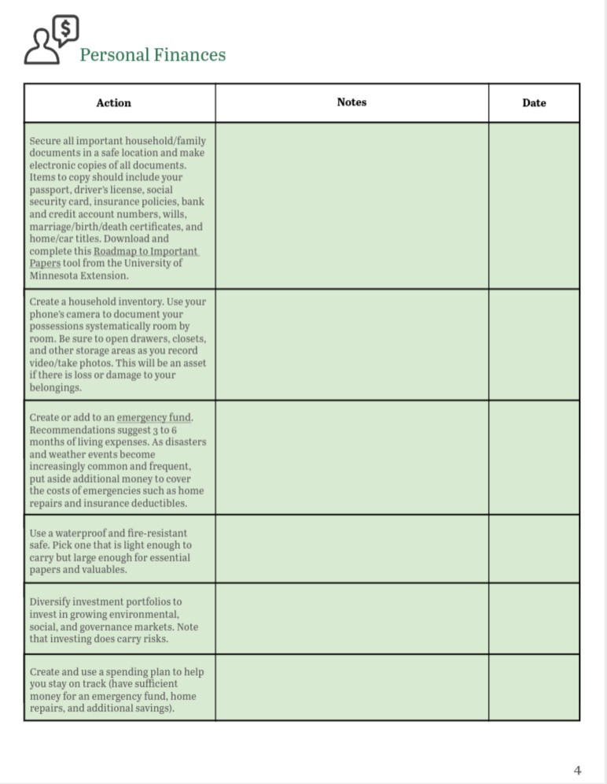
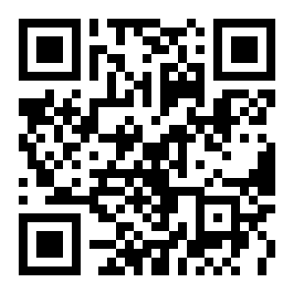
Tool
Free printable resource with ﬁll-in-the-blanks for goal completion and tracking
Notes:
DO: Distribute tool providing one per participant. If teaching virtually, ask participants to download the resource if they haven’t already: https://extensiondisaster.net/resource-dashboard/52-ways-to-climate-proof-your-finances/. You can also use this shortened URL to direct participants to the toolkit: https://z.umn.edu/52Ways
SAY: Today we will be using a tool that has been developed by family finance experts across the US Extension system. This tool includes 52 ways you can climate proof your personal finances. We are going to spend time together going through this tool talking about each section and the tasks outlined for completion. While not exhaustive, this tool is an excellent resource to guide our discussions and actions when it comes to climate proofing our personal finances.
It is important to realize that you are not expected to complete all the tasks or to complete all the task at one time. For example, some tasks are one time events while others are recurring actions. This tool is simply a guide – a guide to spark your thinking and get you started on climate proofing your finances.
When you are ready to act, you can use the middle column to identify which actions you plan to work on, what time of year you will complete the task, and to track your progress. Once you have started a habit or completed a task, place a check mark and date in the final column.
Because of our brief time together today we won’t be able to go through each action step in the toolkit. We are now going to do a quick activity to help you become familiar with some of the actions you can take.
Note:
https://extensiondisaster.net/resource-dashboard/52-ways-to-climate-proof-your-finances/
Sara Croymans made a zlink & QR code - https://z.umn.edu/52Ways

Slide 6

Group Activity
Working in your group:
Review assigned topic(s)
Pick 2 favorite action items
Report out to larger group
Notes:
DO: Divide participants into small groups of 3-5 participants. If teaching a virtual lesson, place groups in breakout rooms. Depending on the number of participants and groups, assign each group 1-3 topical area(s). Give the groups 10 minutes to review their assigned topical areas. Ask each group to pick their two favorite action steps from the lists they reviewed. This can help introduce your class to the types and variety of action steps that are included in the tool.

Slide 7

Group Activity
Reflect:
Why were these your favorites?
Are they the easiest to do or do they have the biggest impact?
Do they cost the least to do?
For ones that are more expensive, how would you fund those improvements?
Notes:
DO: Have each group report to the full group their favorite action steps and why. You can use the questions on this slide to help guide the discussion.

Slide 8
Moving Forward
Review “52 Ways to Climate Proof Finances” at home.
Discuss action steps with others.
Identify action steps for adoption.
Notes:
DO: Encourage participants to review the “52 Ways to Climate Proof Your Finances” tool in its entirety on their own time and share and discuss the strategies with others. Talk with signiﬁcant others to identify which tasks make the most sense and ask them to prioritize the most important and when they might want to complete the steps.
Encourage participants to celebrate their successes as they complete some tasks and make progress on others! Planning for and dealing with the risks posed by climate change will need commitment from everyone. Remind them that the steps they’re taking are making a diﬀerence for their family and community.

Slide 9
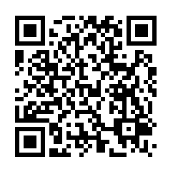
Evaluation
Notes:
DO: Ask participants to complete the online evaluation.
Eval URL - https://uaex.co1.qualtrics.com/jfe/form/SV_bKI5iZA5ER9U56K
If you are teaching the class in person, please distribute a paper copy of the evaluation if participants can’t easily access it via the QR code. If you are teaching the class virtually, please copy and paste the link to the evaluation in the chat so that folks who are on computers can access it that way.
Please remind participants to indicate their state (so that it will be easier for you to get a report of results from your state’s classes) and to indicate whether they attended a 60-minute or 30-minute lesson. To get a report of your evaluation results please contact Laura Hendrix at lhendrix@uada.edu.

Slide 11
References
U.S. Department of the Treasury. (2023). The Impact of Climate Change on American Household Finances. https://home.treasury.gov/system/ﬁles/136/Climate_Change_ Household_Finances.pdf
U.S. Global Change Research Program (USGCRP). (2023). Fifth National Climate Assessment. Crimmins, A.R., C.W. Avery, D.R. Easterling, K.E. Kunkel, B.C. Stewart, and T.K. Maycock, Eds.
U.S. Global Change Research Program, Washington, DC, USA. https://doi.org/10.7930/NCA5.2023

Slide 12
Resources
Abel, J., Tobe, E., Gruder, S., Ruemenapp, M. (2023). How the Inﬂation Reduction Act Can Save You Money on Home Energy Costs. https://ﬁnances.extension.wisc.edu/ﬁles/2023/10/Inﬂation-Reduction-Act-Fact-sheet- 1.pdf
Roop, Heidi A. (2023). The Climate Action Handbook: A visual guide to 100 climate solutions for everyone. Sasquatch Books.
Stookey, David W. (2016). Climate Proof Your Personal Finances: How (and where) to safeguard your family budget and lifestyle. Savvy Families Institute, Newport, RI.
U.S. Department of Treasury. (2023). The Impact of Climate Change on American Household Finances. https://home.treasury.gov/system/ﬁles/136/Climate_Change_Household_Finances.pdf

Slide 13
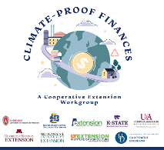
Contributors
Jenny Abel, MS, AFC, Financial Security Outreach Program Manager, University of Wisconsin-Madison Division of Extension
Sara Croymans, MEd, AFC, Extension Educator, Family Resiliency and Extension Professor, University of Minnesota Extension
Carrie Grishaber, MSW, Finance and Homeownership Educator, Michigan State University Extension
Laura Hendrix, Ph.D., Professor, University of Arkansas System Division of Agriculture Cooperative Extension Service
Portia Johnson, Ph.D., Assistant Professor/Extension Specialist, Consumer & Design Sciences, Auburn University
Elizabeth Kiss, Ph.D., Professor and Extension Specialist, Kansas State University
Lorna Saboe-Wounded Head, Ph.D., AFC, CFCS, CPFFE, Family Resource Management Field Specialist, South Dakota State University Extension
Kelly Sipple, MEd, Financial Well-being Extension Agent, University of Delaware Cooperative Extension
Christopher T. Sneed, Ph.D., Associate Professor and Consumer Economics Specialist, The University of Tennessee Extension
Erica Tobe, Ph.D., Extension Specialist, Michigan State University Extension

Slide 14
Reviewers
Jonathon Ferguson, MS, CFP, Financial Capability Learning Specialist, University of Wisconsin-Madison Division of Extension
M. E. Betsy Garrison, Ph.D., Professor, Human Sciences, University of Arkansas
Daniel McDonald, Ph.D., Director, Take Charge America Institute for Consumer Financial Education and Research, and Extension Specialist, Financial Education, University of Arizona
Jinnifer Ortquist, MS, CFLE, CHRS, Finance and Homeownership Educator, Michigan State University
Design and Layout
Janie Greene, Human Science Field Intern, Auburn University

Slide 15
Thank you!

