Slide 1
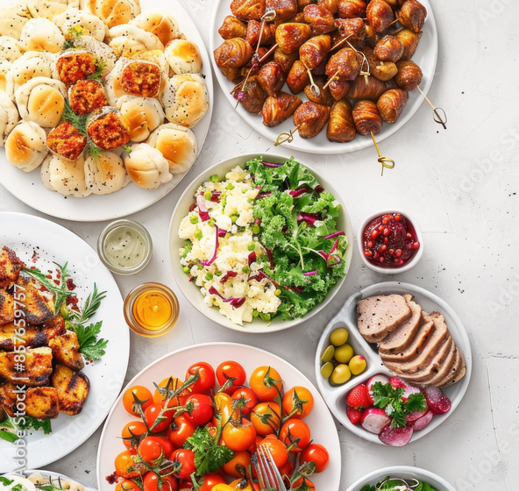
Keeping Safe: Food, Fundraisers, Potlucks & Picnics
Reducing foodborne illness risk at group events
Notes:
Introduce the topic and explain why food safety matters at community events.

Slide 2

What Is Foodborne Illness?
Symptoms: nausea, vomiting, diarrhea, fever
Causes: bacteria, viruses, parasites
Often caused by Poor Personal Hygiene, Contamination, or Improper: Cooking, Holding, or Cooling
High-risk groups: young, elderly, immunocompromised
Notes:
Handout 1 – Common Germs That Can Cause Foodborne Illness

Slide 3
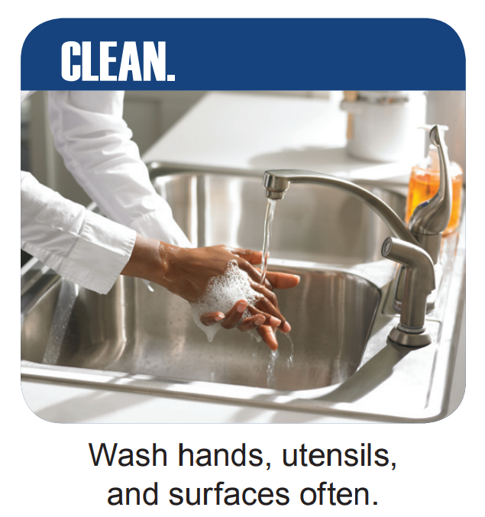
How Bacteria Get Into Food
Raw meat, poultry, seafood, eggs, and produce can carry bacteria.
Wash all fruits and vegetables
Cross-contamination can occur during handling.
Wash hands often.
Notes:
Explain sources of contamination and importance of handling food safely.

Slide 4
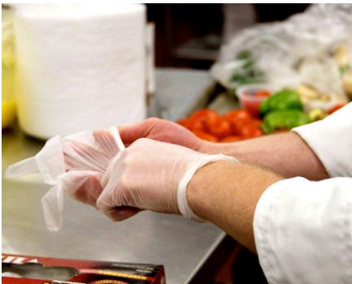
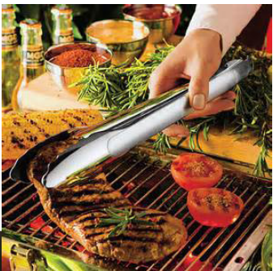
When preparing or Serving Foods -
No Bare-Hand Contact with ready-to-eat food
Ready-to-eat food is food that can be consumed without further preparation
Use Single-use gloves
Tongs or Spatulas
Deli-tissue

Slide 5
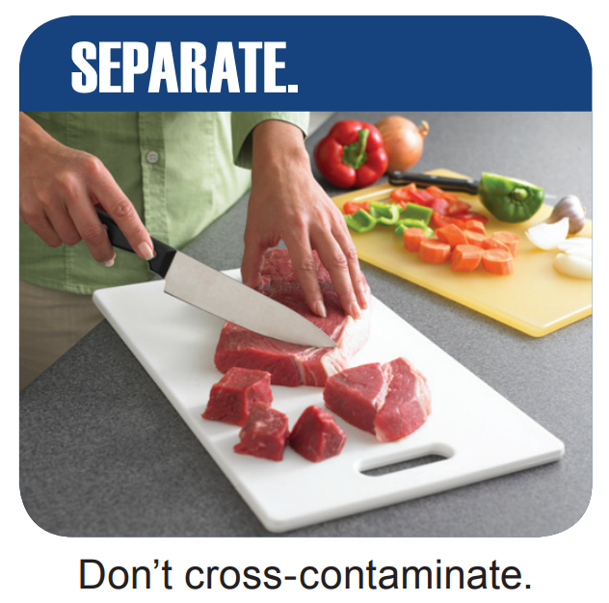
Avoid Cross-Contamination
Keep raw and cooked foods separate.
Use separate cutting boards and utensils.
Notes:
Demonstrate how to prevent cross-contamination during food prep.

Slide 6

Event-Specific Food Safety
Transport cold foods in coolers
Keep dishes on ice
Serve in small batches
Discard unsafe leftovers.
Notes:
Handout 2 – Cold Storage Chart

Slide 7
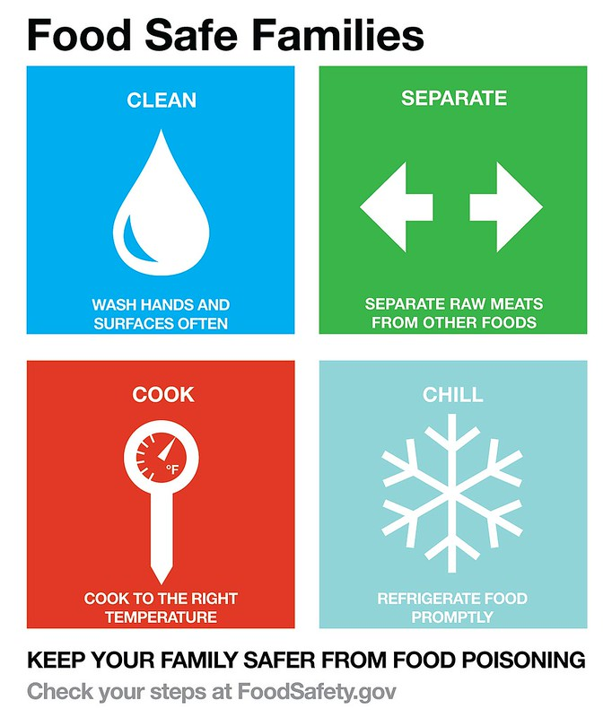
4 Steps to Food Safety
Clean
Separate
Cook
Chill
Notes:
Review USDA's four steps and demonstrate each with examples.

Slide 8
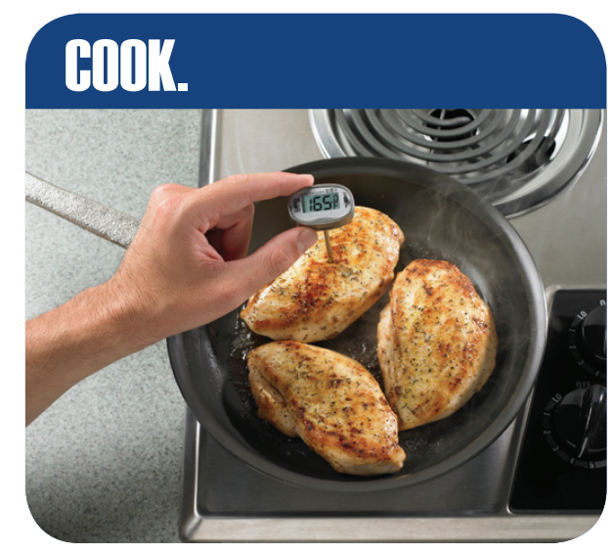
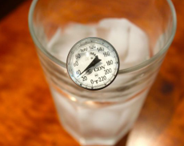
Using a Food Thermometer
Insert into thickest part, avoid bone, hold for 15 seconds.
Calibrate regularly.
Notes:
Handout 3: Safe Internal Temperature Chart
Handout 4: How to Calibrate

Slide 9
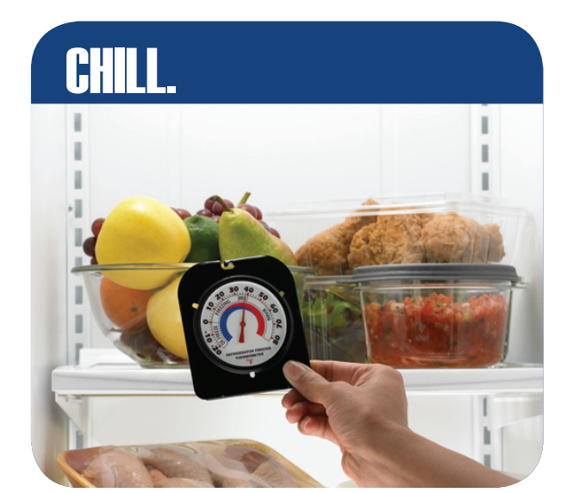
Shopping, Serving, and Storing Safely
Follow USDA tips:
Separate raw meats
Keep hot foods hot and cold foods cold
Refrigerate within 2 hours of shopping or preparing (within 1 hour if 90 degrees or hotter)
Label/Date leftovers to use or toss quickly
Notes:
Discuss shopping strategies and safe storage practices.

Slide 10
Allergen & Ingredient Labeling
Label allergens
With potlucks – feel free to include recipes
Keep separate utensils with each dish to reduce cross-contact
Notes:
Explain importance of allergen labeling and preventing cross-contact.

