Slide 1

Navigate the Great 8 Wellness Dimensions
Exploring key aspects for balanced and healthy living
Notes:
AI-generated content may be incorrect. ---

Slide 2
Introduction and Overview
Notes:
Introduction to Navigate the Great 8, The Great 8 Dimensions of Wellness

Slide 3

Introduction to Navigate the Great 8
Holistic Wellness Dimensions
  The program covers eight distinct wellness dimensions promoting overall holistic well-being.
Interactive Station Rotation
  Participants rotate through stations completing activities to explore each wellness dimension deeply.
Personalized Wellness Map
  Participants create a personalized Wellness Map to track insights and action steps for balance.
Focus on Practical Steps
  The session emphasizes practical, actionable wellness steps rather than perfection.
Notes:
The Navigate the Great 8 Wellness Dimensions program is designed to engage participants in an interactive journey through eight distinct dimensions of wellness. This approach emphasizes holistic well-being by encouraging individuals to explore emotional, physical, social, intellectual, spiritual, occupational, environmental, and financial aspects of their lives. The session begins with an overview of the activity structure: participants will rotate through eight stations, each dedicated to one wellness dimension. At each station, they will complete fun and reflective activities, gather insights, and record action steps on a personalized Wellness Map. This map serves as a tangible guide for maintaining balance and attention across all dimensions. The facilitator introduces the concept by highlighting that wellness is not about perfection but about paying attention to areas that matter most. By the end of the session, participants will have identified practical steps to enhance their well-being and will leave with a clear plan for integrating these actions into their daily lives.

Slide 4
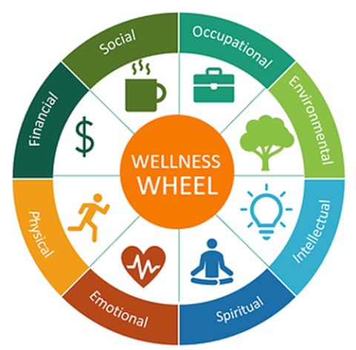
The Great 8 Dimensions of Wellness
Emotional Wellness
  Focuses on managing emotions, coping with stress, and building personal resilience for mental health.
Physical Wellness
  Emphasizes exercise, nutrition, and rest to maintain a healthy and strong body.
Social Wellness
  Involves fostering meaningful relationships and connecting with community for social support.
Intellectual Wellness
  Encourages lifelong learning and mental stimulation to grow knowledge and creativity.
Spiritual Wellness
  Finding purpose and meaning by aligning actions with personal values and beliefs.
Occupational Wellness
  Finding satisfaction and purpose in work or volunteer roles that bring fulfillment.
Environmental Wellness
  Promotes living in harmony with surroundings and supporting sustainability efforts.
Financial Wellness
  Focuses on managing money wisely and planning for future financial security.
Notes:
The eight dimensions of wellness provide a comprehensive framework for understanding and improving overall well-being. Emotional wellness focuses on managing emotions, coping with stress, and building resilience. Physical wellness emphasizes maintaining a healthy body through exercise, nutrition, and adequate rest. Social wellness involves fostering meaningful relationships and community connections. Intellectual wellness encourages lifelong learning and mental stimulation. Spiritual wellness is about finding purpose, meaning, and aligning actions with personal values. Occupational wellness relates to finding satisfaction and purpose in work or volunteer roles. Environmental wellness promotes living in harmony with surroundings and supporting sustainability. Financial wellness addresses managing money wisely and planning for future security. Together, these dimensions create a balanced approach to health, ensuring that individuals pay attention to all aspects of their lives rather than focusing on one area alone. Understanding these dimensions helps participants identify strengths and areas for growth, setting the stage for actionable change.

Slide 5
Wellness Dimensions and Activities
Notes:
Emotional and Physical Wellness, Social and Intellectual Wellness, Spiritual and Occupational Wellness, Environmental and Financial Wellness

Slide 6

Emotional and Physical Wellness
Emotional Wellness Activities
  Engaging in activities like Emoji Charades enhances emotional awareness and helps manage emotions effectively.
Setting Emotional Boundaries
  Reflecting on emotional limits encourages setting boundaries for improved emotional resilience and self-care.
Physical Wellness Exercises
  Simple physical activities like stretches and breathing exercises support maintaining a healthy body and routine.
Incorporating Healthy Habits
  Identifying doable physical habits and recording them promotes consistent action toward physical health goals.
Notes:
Emotional wellness is about recognizing and managing emotions effectively, coping with stress, and maintaining resilience. At the Emotional station, participants engage in Emoji Charades, an interactive activity where they act out emojis to spark discussion about emotional awareness. The action step involves reflecting on signs that indicate emotional limits and adding one emotional boundary to their Wellness Map. Physical wellness focuses on maintaining a healthy body through exercise, nutrition, and sleep. The Physical station features a Two-Minute Tune-Up, which includes stretches, posture checks, breathing exercises, or marching in place. Participants identify one simple way to incorporate physical activity into their weekly routine and record a doable physical habit on their Wellness Map. These activities encourage participants to take small, actionable steps toward emotional balance and physical health, reinforcing the importance of self-care and proactive habits for overall well-being.

Slide 7

Social and Intellectual Wellness
Building Social Connections
  Social wellness focuses on creating healthy relationships and sharing memorable experiences to strengthen bonds.
Reconnecting Action Step
  Participants identify someone to reconnect with and mark it on their personal Wellness Map as a social goal.
Promoting Intellectual Growth
  Intellectual wellness encourages lifelong learning through activities like optical illusion challenges promoting critical thinking.
Setting Intellectual Goals
  Participants write learning objectives and new perspectives on their Wellness Map to foster mental stimulation.
Notes:
Social wellness emphasizes building healthy relationships and fostering community connections. At the Social station, participants engage in a Story Swap, sharing memorable experiences to strengthen camaraderie and highlight shared values. The action step is to identify one person they would like to reconnect with and note this on their Wellness Map. Intellectual wellness promotes lifelong learning and mental stimulation. The Intellectual station features the Brain Spark Challenge, where participants examine optical illusions and discuss different perspectives. This activity encourages open-mindedness and critical thinking. Participants then write one learning goal and a new perspective they wish to adopt on their Wellness Map. These stations help participants appreciate the value of social bonds and intellectual growth, both of which contribute to a fulfilling and balanced life.

Slide 8
Spiritual and Occupational Wellness
Spiritual Wellness Practices
  Spiritual wellness enhances inner peace through meditation, quiet reflection, and aligning life with personal values.
Meaning and Purpose Reflection
  Reflection exercises help identify what gives life meaning and provide grounding or purpose.
Occupational Wellness Activities
  Work Joy Match-Up connects joy at work with creativity or teamwork, promoting satisfaction and intentionality.
Aligning Work with Values
  Participants identify tasks to approach intentionally, aligning daily work with personal values and professional joy.
Notes:
Spiritual wellness involves finding meaning and purpose in life and aligning actions with personal values. At the Spiritual station, participants choose between a Meditation Moment or Quiet Reflection exercise, focusing on breathing and visualization to promote inner peace. Reflection questions guide participants to consider what gives their life meaning and where they feel most connected. They then write one thing that provides grounding or purpose on their Wellness Map. Occupational wellness centers on finding satisfaction and purpose in work or volunteer roles. The Occupational station includes a Work Joy Match-Up activity, where participants select a word representing what brings them joy at work, such as creativity or teamwork, and share why. They record one task they want to approach with greater intentionality on their Wellness Map. These activities encourage participants to align their daily actions with their values and find joy in their professional lives.

Slide 9



Environmental and Financial Wellness
Environmental Wellness Focus
Encourages creating harmonious, sustainable surroundings through practical changes like adding plants or decluttering.
Financial Wellness Importance
Involves managing money wisely and aligning spending with personal values such as family and health.
Practical Wellness Actions
Participants identify one environmental and one financial habit to improve overall well-being and balance.
Notes:
Environmental wellness focuses on creating harmonious surroundings and promoting sustainability. At the Environmental station, participants brainstorm ways to improve their workspace or home, such as adding a plant or decluttering a drawer. They record one environmental change they want to try on their Wellness Map. Financial wellness involves managing money wisely and planning for the future. The Financial station features a Values Budgeting activity, where participants prioritize values like family, health, and learning, then reflect on how their spending aligns with these priorities. They identify one small financial habit to implement and note it on their Wellness Map. These stations help participants recognize the impact of their environment and financial decisions on overall well-being, encouraging practical steps toward balance and security.

Slide 10
Debrief and Closing
Notes:
Reflection and Action Steps, Closing Thought and Materials

Slide 11
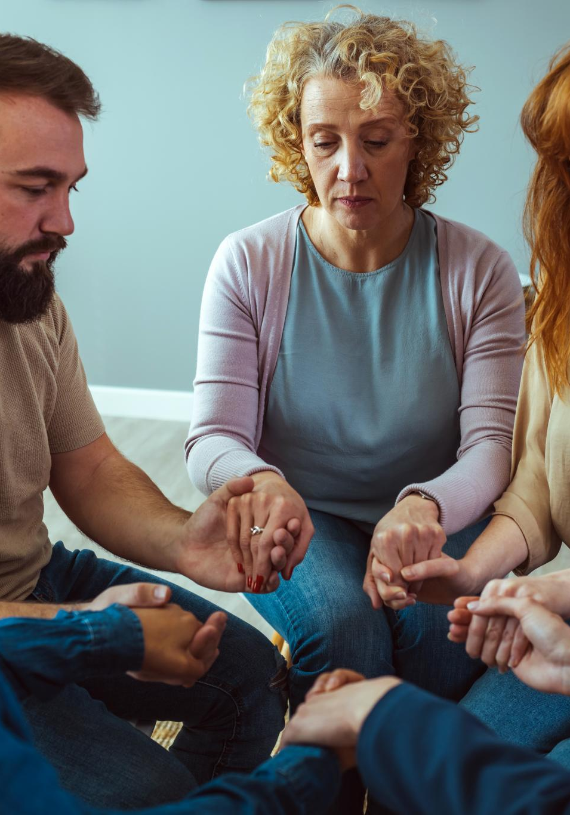
Reflection and Action Steps
Reflection on Experiences
  Participants reflect on their experiences to consolidate learning and gain deeper insights into wellness dimensions.
Guided Reflection Questions
  Key questions prompt awareness of surprises, challenges, strengths, and connections to wellness dimensions.
Commitment to Action
  Participants commit to small actionable steps to improve their wellness, enhancing accountability and growth.
Sharing and Accountability
  Sharing reflections aloud or silently strengthens commitment to personal growth and holistic well-being.
Notes:
The debrief session allows participants to reflect on their experiences and consolidate learning. Key questions include: Which station surprised you the most and why? Which wellness dimension felt easiest to connect with? Which one challenged you or made you think differently? Where do you notice existing strengths? What small action are you most excited to try from your Wellness Map? These reflections help participants internalize insights and commit to actionable steps. The facilitator then invites participants to finish the sentence: 'One thing I will do this week is…' This exercise reinforces accountability and encourages immediate application of wellness strategies. By sharing reflections aloud or silently, participants strengthen their commitment to personal growth and holistic well-being.

Slide 12

Closing Thought and Materials
Wellness Philosophy
  Wellness is an ongoing process focused on awareness and intentionality, not perfection.
Personalized Wellness Map
  Participants receive a personalized Wellness Map highlighting focus areas and actionable steps.
Session Materials
  Essential materials include flipcharts, markers, index cards, pens, chairs, and a quiet space.
Encouragement for Ongoing Journey
  Participants are encouraged to apply insights and maintain habits for a balanced, fulfilling life.
Notes:
The session concludes with a powerful reminder: 'Wellness is not perfection—it is paying attention.' This statement emphasizes that wellness is an ongoing process of awareness and intentionality rather than striving for flawlessness. Participants leave with a personalized Wellness Map that highlights areas for attention and actionable steps to enhance their well-being. Essential materials for the session include flipcharts, markers, index cards, a quiet space with chairs, pens or pencils, and the Wellness Map handout. These resources support interactive activities and reflection exercises, ensuring participants have a meaningful and engaging experience. The closing thought encourages participants to continue their wellness journey beyond the session, applying the insights and habits they have identified to create a balanced and fulfilling life.

