Slide 1

Smartphone Smarts Guide to Healthier Scrolling Habits
Presented by: [Insert name]

Slide 2

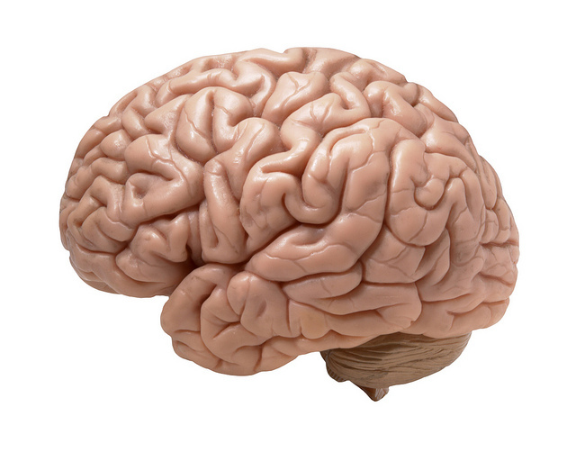
Technology and Novelty
Addictive Properties of Social Media

Slide 3
What’s the Problem with Excessive Smartphone Use?
Depression
Anxiety
Loneliness
Excessive screen time is linked to problems with impulse control, attention, mood regulation and other executive function skills

Slide 4
Exposure to Negative Content
Targeted Advertising
Doomscrolling
AI & Bots
Scams
Misinformation

Slide 5
Healthier Scrolling Habits
Turn off notifications
Turn on filters
Set timers and screentime limits
Avoid screens before bed
Unfollow or mute social media that doesn’t add value to you
Don’t click on unknown links

Slide 6
Smartphone Smarts Guide to Healthier Scrolling Habits
Presented by: [Insert name]

