Slide 1



It’s OK to Talk about
Mental Health
Tips for Tough Conversations
Prepared by:
Dr. Brittney Schrick, Ph.D., CFLE
Associate Professor & Family Life Specialist
UADA Cooperative Extension

Slide 2
Is it difficult to talk about mental health?
Why?
Fear of judgment
Lack of understanding
Past experiences
Family norms
Community norms
Cultural influence
Notes:
Ask: “Is it difficult to talk about mental health?” [allow responses]
Ask: “Why?” [Or if the group consensus is that it ISN’T difficult, ask them to share.]
There are often barriers that get in the way of someone’s comfort discussing mental health. Some of those may include:
Fear of judgment from others
Lack of understanding or knowledge about mental illness
Past experiences when telling someone about a mental health challenge or when talking to someone who is struggling with mental health
Family or community norms that influence how mental illness is discussed and treated.
Cultural factors that may influence how people approach mental and/or physical health issues.
Sometimes discussing topics like mental health, substance use, or other sensitive topics can be difficult. You may have family or other community or cultural taboos about such topics.
You may have had a bad experience in the past that makes you reluctant to talk to or about someone experiencing a mental health challenge or to disclose that you are struggling with your own mental health.

Slide 3
Stigma
Negative attitude associated with a specific issue.
Notes:
All of these barriers are the result of stigma surrounding mental illness. Stigma is a negative attitude associated with a specific issue. The negative attitude may lead to discomfort or even negative behavior toward someone who is experiencing, or is perceived to experience, that issue. For example, someone who is diagnosed with bipolar disorder may be reluctant to tell their friends or family because they have heard negative stories about “bipolar people.” Media reports, family and community stories, and other sources can influence how others think about individuals who experience mental illness, even if they have never met someone with that diagnosis.

Slide 4
Person-First
Language
Centers the WHOLE person rather than their disease, disorder, or challenge.
Notes:
Stigmatizing language can lead people to think of someone as only their disorder. For that reason, it is important to use person-first language when discussing mental health and other challenges. This type of language centers the whole person rather than their disease or disorder. By centering the person, it is easier to remember that they are more than just their challenge; they have a whole life and a whole history, just like you do.

Slide 5
Non-Stigmatizing, Person-First language
Instead of …. Try this
“He’s struggling with substance abuse.”
“He’s an addict.”
“She was diagnosed with bipolar disorder.”
“She’s bipolar.”
“I wonder what they’re struggling with.”
“They’re crazy.”
Notes:
Just as you wouldn’t say, “He’s cancer” or “She’s arthritis,” using a diagnosis to describe someone dismisses their humanity and minimizes their ability to recover or improve. In addition, general terms like “crazy,” “insane,” “bonkers,” etc. may imply that the person’s mental illness is something to fear or assign mental illness where none exists.
Some examples of changing stigmatizing language to person-first language include:
Instead of: “He’s an addict.” Try: “He’s struggling with substance abuse.”
Instead of: “She’s bipolar.” Try: “She was diagnosed with bipolar disorder.”
Instead of: “They’re crazy.” Try: “I wonder what they’re struggling with?”
Although this seems like a small change, it can be empowering and life-affirming to someone experiencing a mental health challenge or crisis by reminding them that they are more than their challenges. They bring a whole, complicated person to the world who is unlike anyone else.

Slide 6
How can I start a conversation about mental health?
Notes:
If you have noticed changes in behavior or other concerning signs, how should you start a conversation with someone to talk to them about what you’ve seen?

Slide 7
Why me?
Ask yourself
Why now?
Why not?
Notes:
When deciding whether, when, and how to talk to someone you are close to about their (or your own) mental health, it is important to ask yourself a few questions: Why me? Why now? Why not?

Slide 8
Why me?
Are you an appropriate person to start this conversation?
What is your relationship to the person you’re concerned about?
Notes:
Why me? Are you an appropriate person to start this conversation?
When answering this question, think about your relationship with the person you plan to talk to. Will they feel comfortable talking to you? If not, is there someone else you could mention your concerns to who would be more appropriate? Sometimes, you are not the right person, and that’s ok. If you share your concerns with someone else, you may want to follow up with them later.
If you decide that, yes, you ARE an appropriate person, then ask:

Slide 9
Why now?
What have you noticed that is causing concern?
What is going on that leads you to think that now is the time to address it?
Notes:
2. Why now? What have you noticed that is causing concern? What is going on that leads you to think that now is the time?
First and foremost, do they seem to be in danger of harming themselves or someone else? If YES, then it is important to get help immediately by calling 911, taking the person to the hospital (if that is a safe option for you and for them), or calling the 988 suicide prevention and crisis lifeline.
If not, consider the following:
Have you noticed behavior that is out of character such as missing out on things they usually enjoy doing, giving away prized possessions, missing appointments or meetings, acting erratically, or other changes?
Have you noticed changes in mood, hygiene, appearance, or the way they speak about things?
Have you noticed others around this person who are similarly concerned?
If the answer to any of these is yes, then you probably have a good reason to want to discuss your concerns, so:

Slide 10
Why not?
Do you have time to have this conversation?
Are you willing and able to follow up?
Do you know what next steps are available?
Do you have a plan if they don’t want to talk?
Notes:
3. Why not? Take one last moment to consider the following:
Do you have time and space to have a thoughtful conversation right now? If not, schedule a time to meet when you do.
Are you willing to follow up with this person to check on them or offer assistance beyond this one conversation? If not, you may reconsider if you are the person to approach them.
Do you know what next steps are available in your community, online, or nearby if the person asks for resources? If not, do a little research into what is available beforehand, OR, in a pinch, offer to look for resources with them.
Do you have a plan for what to do if the person you are talking to gets upset or rejects your offer to talk? If not, make a plan. Be prepared for someone to say, “No thanks.” It is easy to say not to take rejection personally, but in the moment, it can feel very personal. React calmly and let them know that you are around if they change their mind.

Slide 11
I think I’m the person, now is the time, and I want to say something…
Notes:
If, after reflecting on Why me? Why now? and Why not? You decide that it’s you, now, and why not! What next?

Slide 12
Approach with Care
DO NOT DIAGNOSE
Use I-Statements
Ask questions, but don’t push.
Follow up
Offer gentle support without judgement.
Be patient
Notes:
Approach with care:
Use I-statements to state in a nonjudgmental way what you have noticed that has caused concern.
For example: “I have noticed that you don’t seem as interested in your garden this year and that you’ve been missing meetings more than in the past. Is everything ok?”
“I noticed that you’ve been sitting alone at meetings and not chatting as much as you used to. Is anything bothering you?”
“The last couple of times we had family dinner, you didn’t come. Are you doing ok?”
Ask questions, but don’t push. If they don’t open up, just let them know you are here if they need you.
Offer gentle support without judgement or comparison. It is not up to you to decide what they do, so removing judgment from your verbal and non-verbal communication as well as trying to limit even internal judgement can allow you to be a supportive, empathetic listener. You don’t have to agree with someone’s feelings, decisions, or behavior to care for or support them; especially if they are seeking help.
DO NOT DIAGNOSE THEM! Unless you are a mental health practitioner, you do not have the education, training, or experience to diagnose someone with a mental illness. If you are concerned that they may be showing signs of mental illness, encourage them to seek help from a professional.
For example: “What you’re describing when you say you don’t feel like yourself anymore and don’t want to get out of bed sounds really hard. Have you thought about talking to your doctor or to another professional?”
“The way you’ve described feeling after you drink sounds uncomfortable. Have you thought about talking to someone who could help you work on that?”
“The feelings you’re describing sound like they’re bothering you. Have you talked to your doctor about it? “
Follow Up:
After you have discussed your concerns, be sure to follow up. This might be a planned follow up that you agree upon such as, “I’ll call you on Monday after your doctor’s appointment to see how everything went.” or “How about I come pick you up for the next meeting?” or “I’m happy to go with you when you meet with that addiction counselor.”
One of the scariest things about disclosing a known mental illness or a concern about mental health or substance use is the fear that people will not accept you or treat you the same if they know. By approaching someone you care about with your concerns, you are offering them a lifeline, sometimes quite literally, to recovery.
And finally, just be patient with them and with yourself. Recovery is a long road, and no matter how much support someone has, there will be bumps along the way.

Slide 13

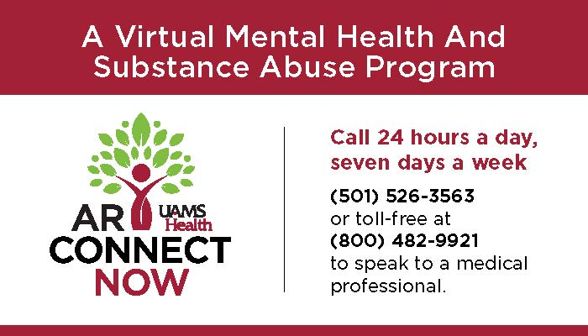
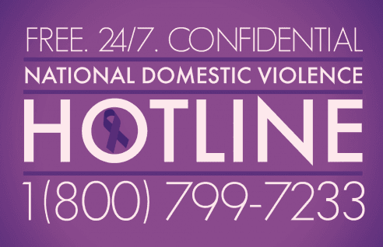
Resources
UAMS ARConnect Now
Notes:
UAMS also has a program called UAMS ARConnect Now, and the information for that is here as well as on your handout. This resource is also available to the public.
I’ve also listed the National Domestic Violence Hotline number and the National Suicide & Crisis Lifeline. It is a good idea to have these numbers saved in your phone or handy at your office. Share them with your admins as well.
We also offer several trainings related to mental health support [click]

Slide 14


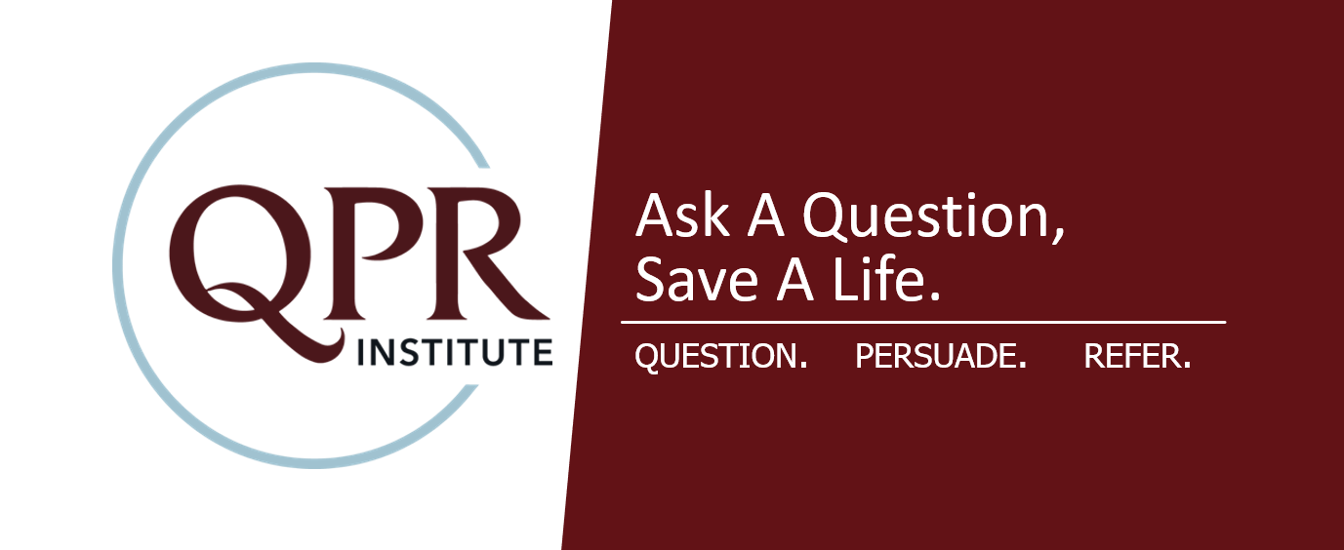
Resources for further information
Notes:
If you are interested in learning more in-depth information about mental health and substance use challenges, gaining more tools to help you respond in a non-crisis or crisis situation, and practice using those tools, reach out to your county agent to schedule Mental Health First Aid in your area.
All county FCS agents have FLIP-IT available. This is a 1 – 2 session program that teaches specific skills related to managing strong emotions.
We also have several county agents and state staff who are trained to facilitate the QPR Suicide Prevention training. QPR stands for Question Persuade Refer, and it specifically trains participants to respond to someone experiencing suicidal thoughts or planning suicide.
Lastly, we have seven trained Mental Health First Aid facilitators. This is an 8-hour program designed to teach participants how to respond to someone experiencing a mental health or substance use challenge.

Slide 15
Questions?
[INSERT AGENT OR EHC CONTACT INFORMATION HERE]
The University of Arkansas System Division of Agriculture offers all its Extension and Research programs to all eligible persons without regard to race, color, sex, gender identity, sexual orientation, national origin, religion, age, disability, marital or veteran status, genetic information, or any other legally protected status, and is an Affirmative Action/Equal Opportunity Employer.
Notes:
Questions?

