Slide 1
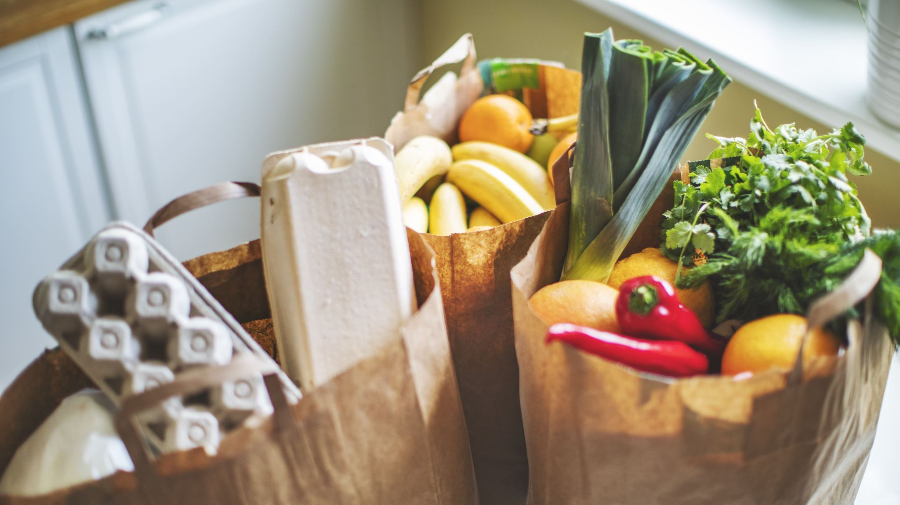
Avoiding Food Waste At Home

Slide 2

How has it made you feel to throw out food?
Notes:
We’ve all thrown out food at one time or another. We’ve overcooked, or forgot about those leftovers in the back of the refrigerators.
How has it made you feel when you’ve thrown food out?
It never feels good. It means we’ve wasted money, and the food may end up in a landfill. It means we’ve wasted water, energy, and natural resources that were used to grow, package, and deliver that food.

Slide 3
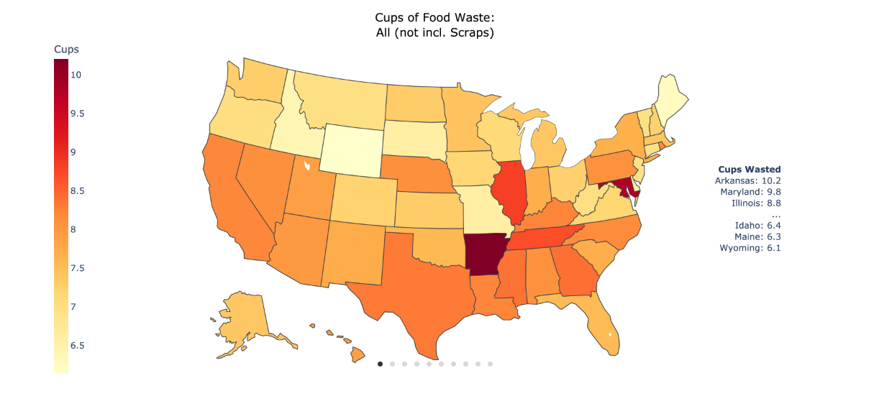
Arkansas: Worst Household Food Waste Offender in the US
Notes:
It turns out that Arkansas has the MOST home food waste of all states. It is estimated that an Arkansas household will waste over 10 cups of food per week.
For more information:
https://sites.mitre.org/household-food-waste

Slide 4
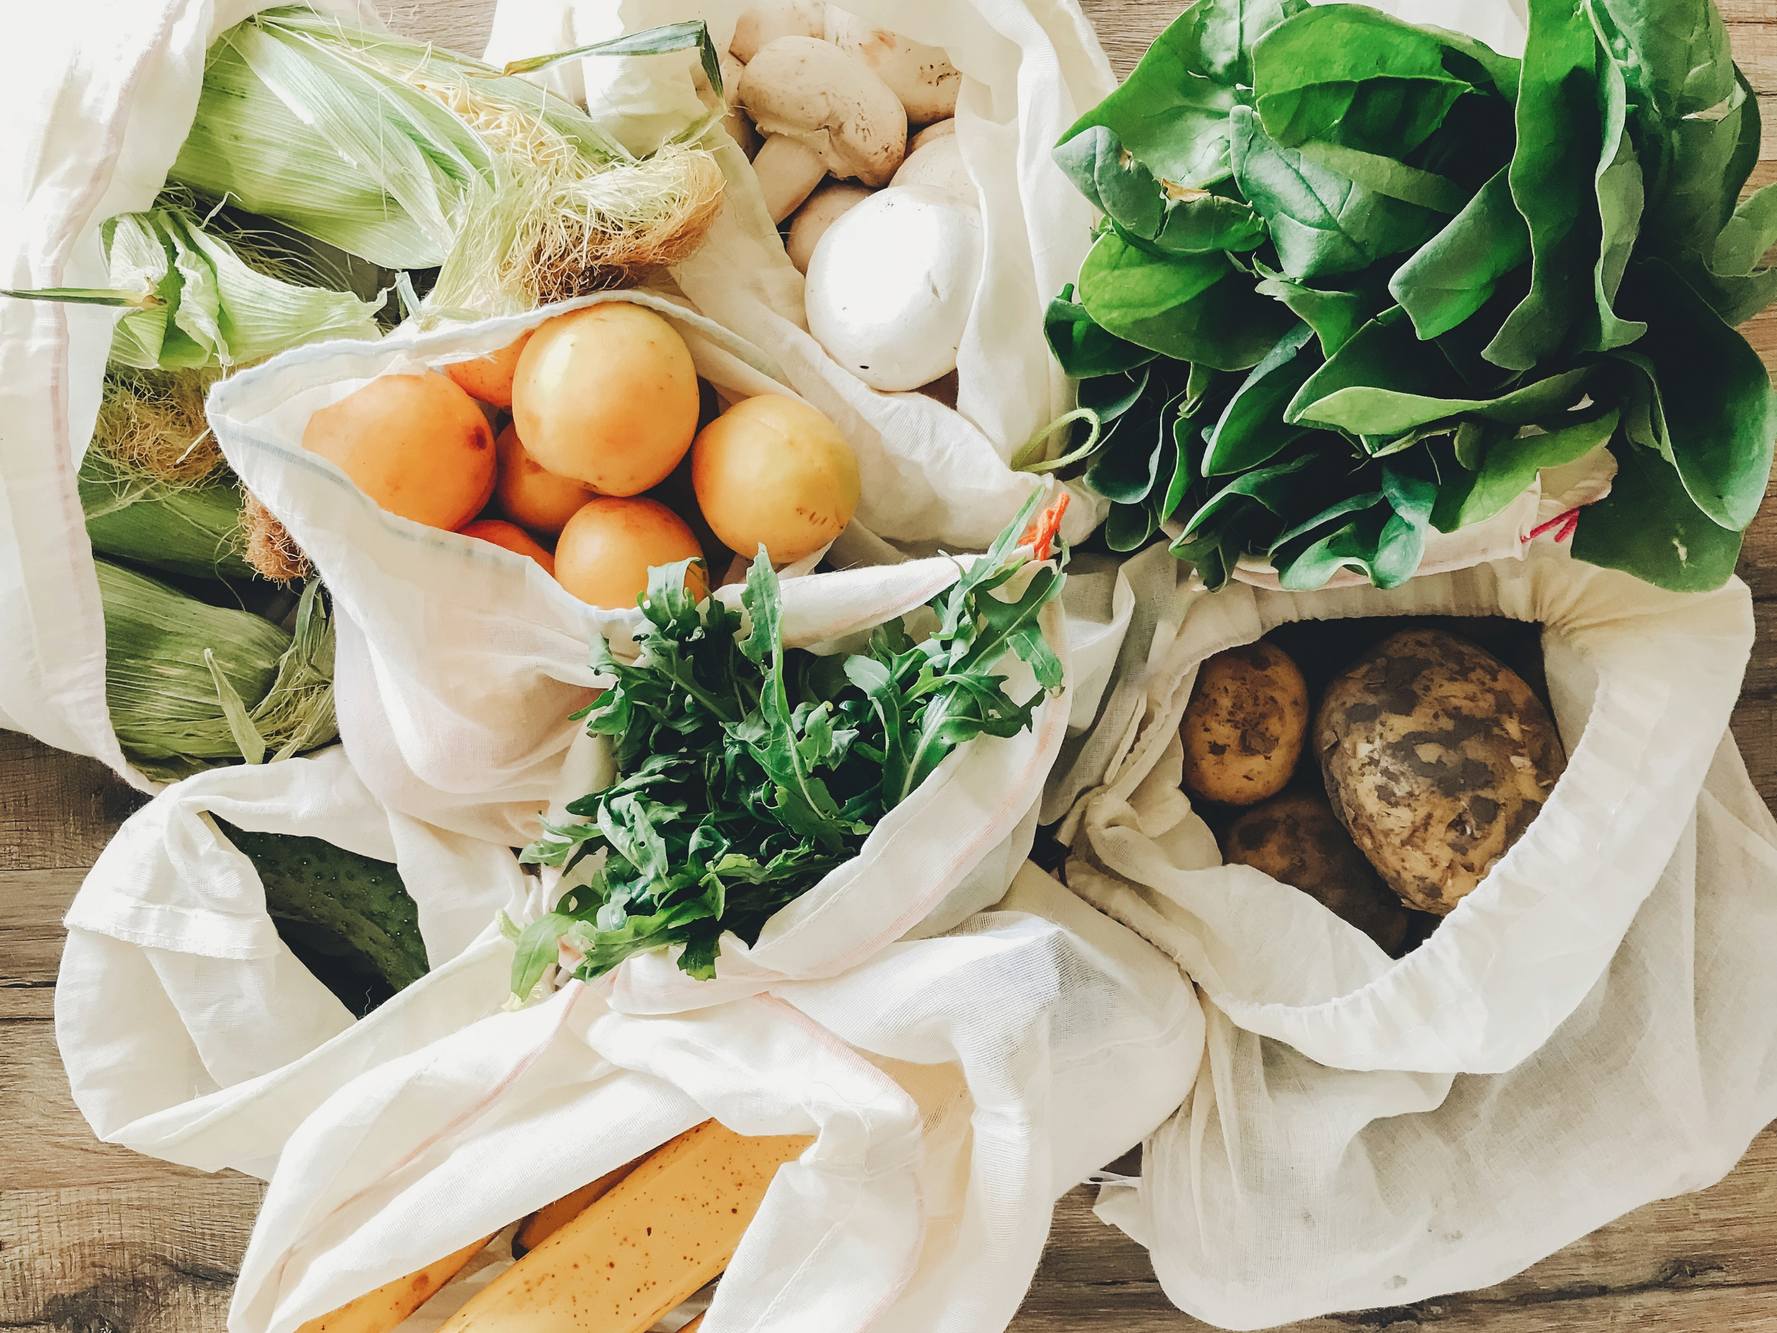
Top sources of Food waste At Home
Produce
Prepared foods
Dairy
Eggs
Notes:
Produce is one of the largest sources of food waste in the home: it spoils quickly, and it can be tempting to over-purchase when you first try out new eating habits.
Have you ever decided you were going to eat healthier, then purchased a lot more berries, fruit, or vegetables than you would realistically eat, for example?
We also throw out a lot of prepared foods, and dairy and eggs. Sometimes that’s because we’re afraid it has gone bad.

Slide 5
Should I throw it out?
Sell by
Best by
Use by
Expiration Date
Notes:
Did you know that the majority of people misunderstand date labels on foods?
For example, the date shown on pasteurized milk typically means the date it should be sold, or the “sell by” date. (In fact, the sell-by date on milk gives you about 10 days of wiggle room, and it’s still fine as long as you’ve kept it properly refrigerated and it still smells good.)
”Best by” means the date by which the flavor or quality may decline, or the food may not perform as well in a recipe.
“Use by” is not a standardized term, but rather an estimated rule of thumb about when to throw out a product.
**The only exception to this rule is baby food, which should not be used after the use-by date. **

Slide 6
Shopping with waste in mind
Plan meals, make a shopping list, and shop YOUR kitchen first
Buy in Season, avoiding large bulk items
Purchase the imperfect and lonely fruits
Be realistic—avoid the “halo” effect
Notes:
-Plan your menus, but “shop”your own kitchen first! Do you have canned foods that need to be eaten, or other produce still-edible produce hiding in the refrigerator bin?
-Buy in season and purchase just what you need, avoiding large, bulk cartons of things that are highly perishable. Keep realistic expectations about how much produce you will eat
-Consider purchasing imperfect vegetables and single pieces of fruit (like a single banana). When these types of unwanted produce are rejected, they often end up discarded, which raises food costs for everyone.

Slide 7

Practical tips to try at Home
Refrigerator makeover
Cabinet inventory & list
Proper storage
Separate foods
Notes:
-Do a refrigerator makeover; organize items that will go bad quickly so that they are seen easily
-Put sticky notes inside cabinets to alert your family about what foods are inside, or make “must be eaten now” notes that indicate which foods should be eaten soon. You can also make labels for foods in the refrigerator to indicate what should be eaten right away.

Slide 8
Special tips for Refrigerator Storage
Temp fluctuates at door; store in back bottom shelf
Eggs: original carton, center of fridge. Those containers aren’t the best.​
Packaged raw meat: tray, bottom shelf​
Produce: ​
HIGHER humidity lever for leafy greens, herbs, cucumbers, ​
LOWER humidity level for apples, pears, stone fruit, avocados
Avocado, banana, kiwi, mango, peach, pear, tomato: Ripen, then refrigerate
Leavy greens, herbs, and cucumbers: Bin, high humidity setting
Apples, pears, stone fruit, avocados: Bin, with lower humidity setting
Keep fruits away from vegetables
Refrigerate bananas if they are ripening too quickly
Keep eggs in their original crate in the middle of refrigerator
Notes:
You can make your food last longer if you learn how to store different types of food properly to slow spoilage.
For example, gasses emitted by foods can make nearby foods spoil more quickly; that’s why fruit and vegetables should be separated in the refrigerator.
And here’s an interesting tip: While It is true that the banana peel will turn dark in the refrigerator, but this will not affect the quality of the fruit inside.
Additional tips include….(Read tips from slide)

Slide 9
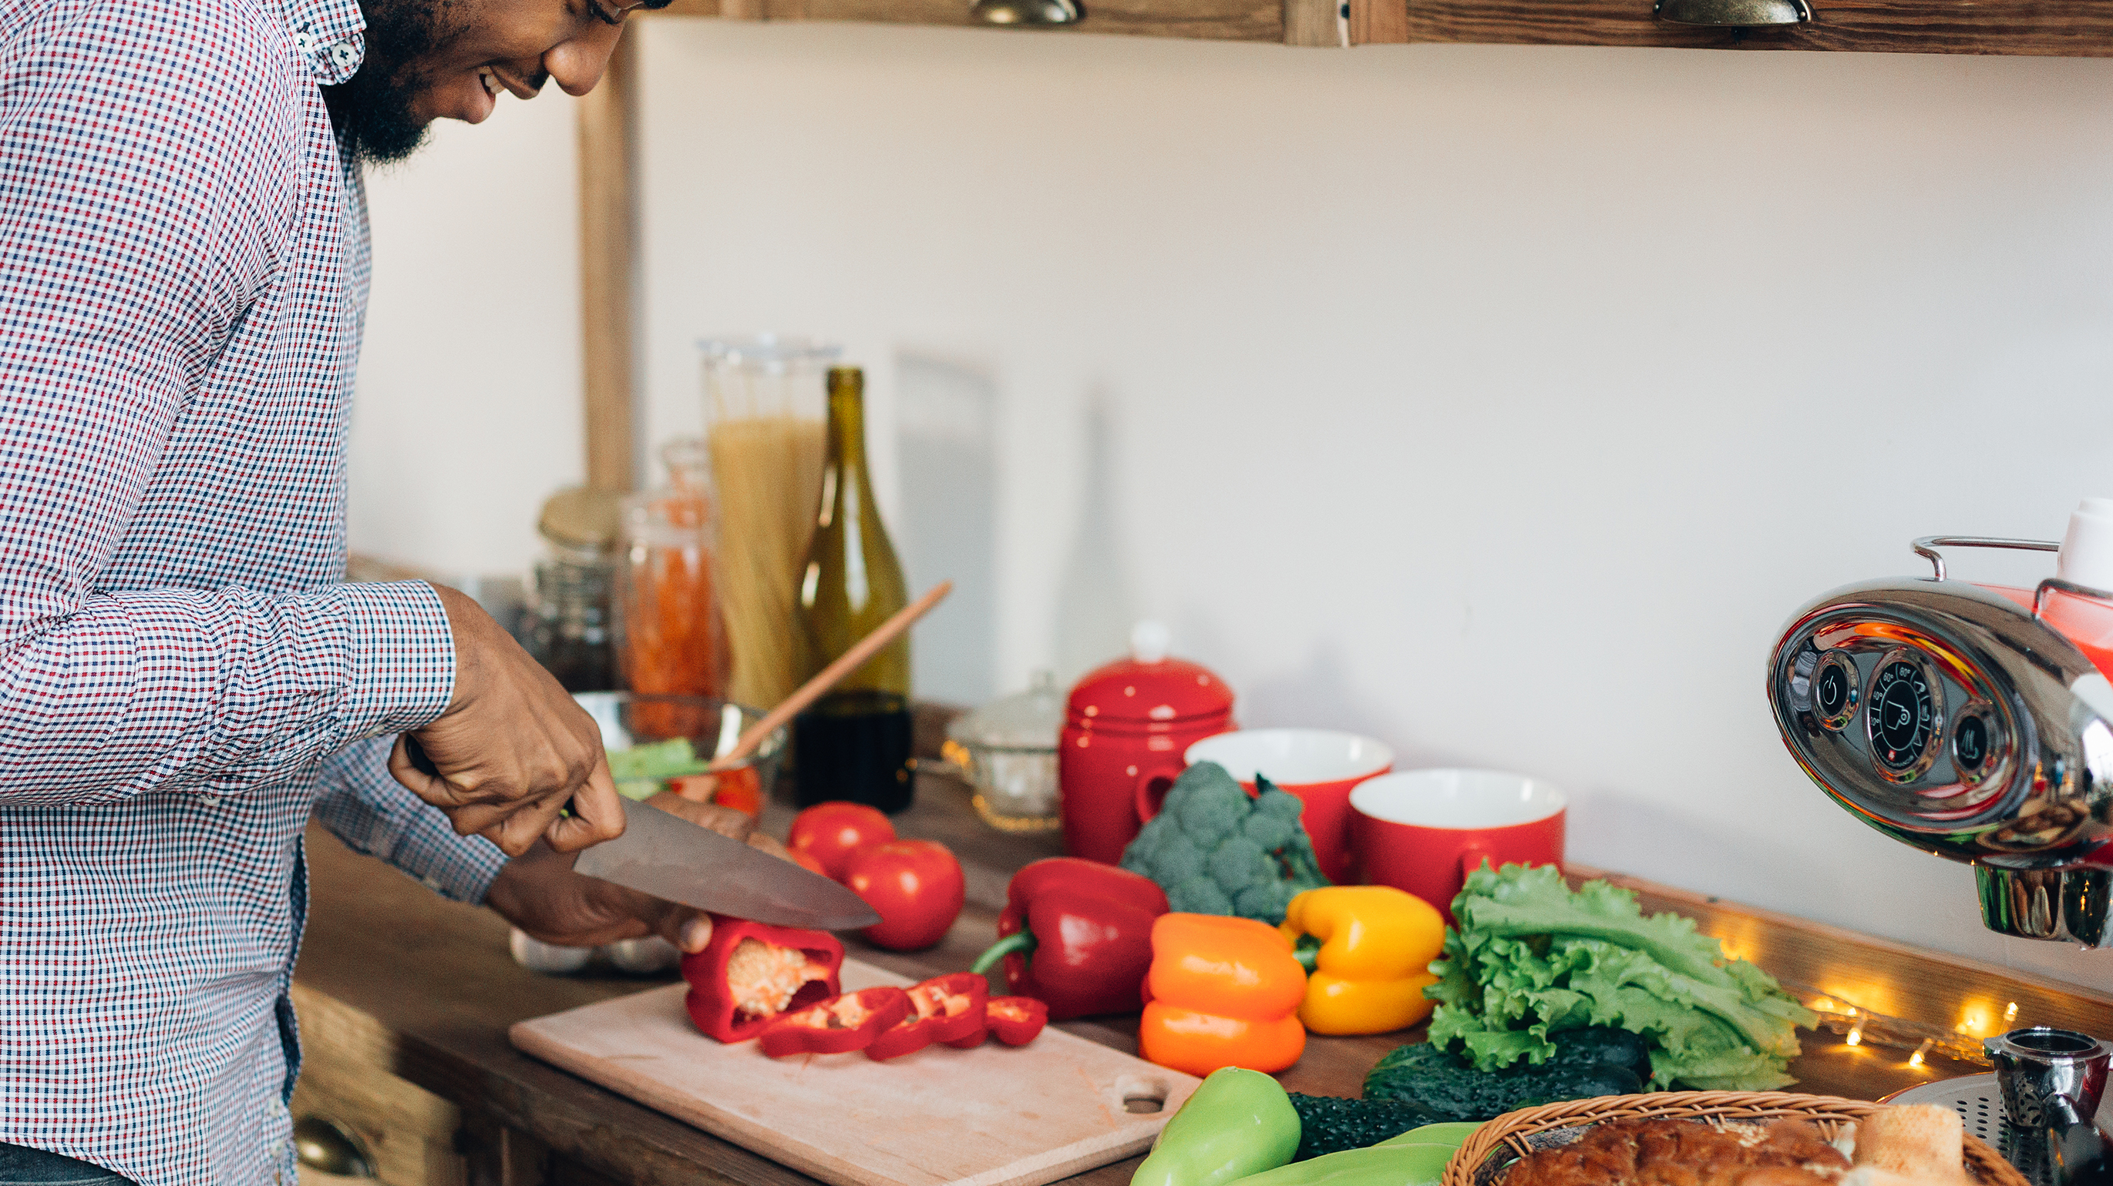
Special tips for Food Preparation
Use everything that you can! Such as:
  Scrub carrots rather than peeling
  Wash, don’t peel, zucchini and cucumbers
  Scrub potatoes well so that skin can be eaten, or
  Turn potato peels into a crispy snack
Notes:
Read from slide

Slide 10
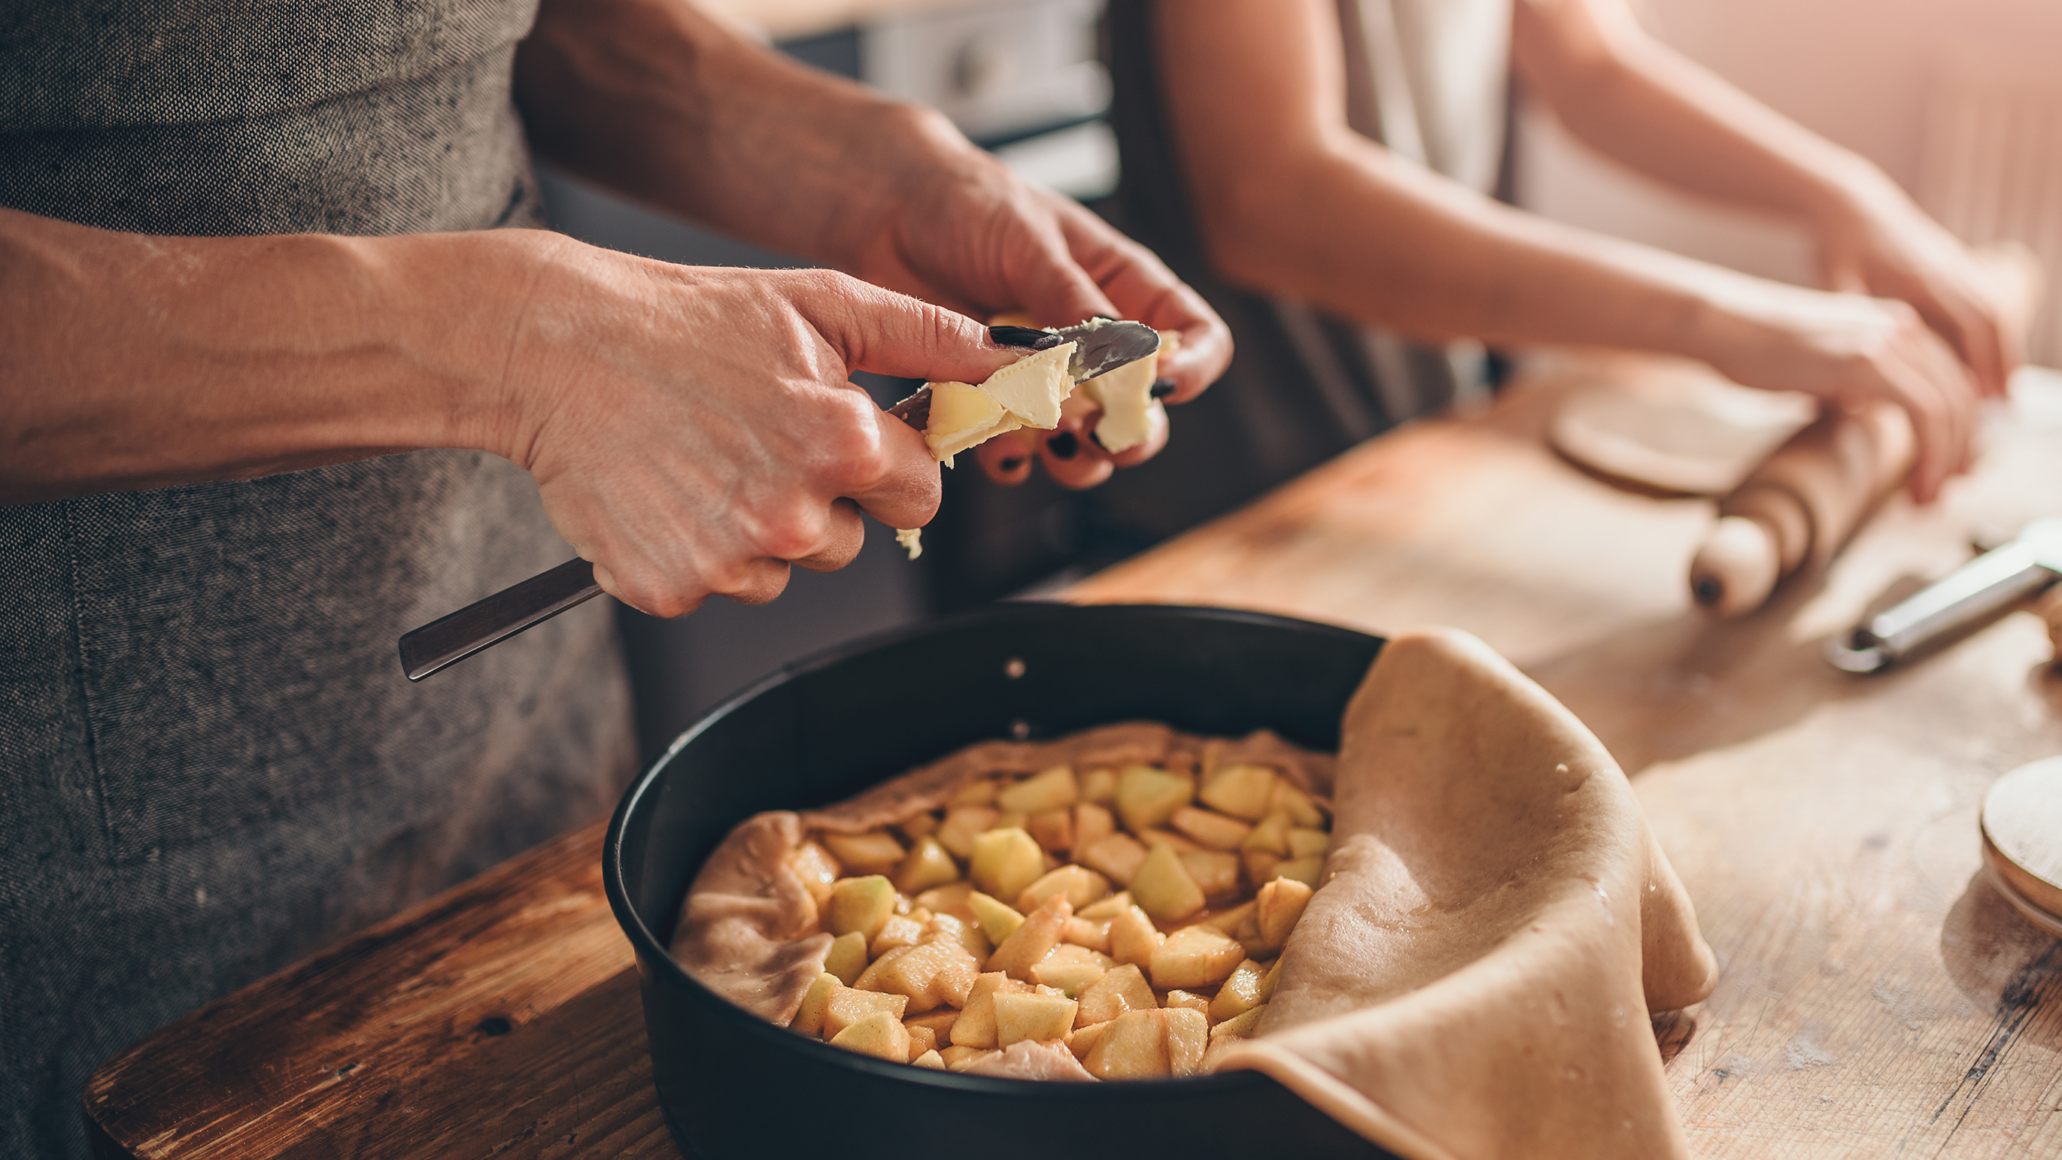
Special tips for Cooking
Use everything you can, such as:
  Scramble leftover vegetables into eggs
  Mix leftover vegetable bits into quinoa, rice, and other whole grains
  Freeze things like dollops of tomato paste that you would have thrown away
  Freeze soup leftovers to mix into another soup later
  Freeze fruits before it goes bad; cut into small chunks to mix in a smoothie later
  Freeze roasted vegetables
Notes:
Read from slide

Slide 11
What Ideas Would You like to share?

