Slide 1
Getting Our
Hearts Right
Three Keys to
Better Relationships
Notes:
Note to agents:
In the notes section of this PowerPoint is the Getting Our Hearts Right lesson guide. It is not meant to be a script; please make this program your own with your own words.
In the appropriate places, we have mentioned the page number of the Getting Our Hearts Right publication that corresponds to the slide content.
On some slides, we have included quotes and stories in italics that you may choose to use or substitute with your own stories. You will notice that many of the quotes are followed by a citation. You will find the corresponding reference information in the notes of the last slide.

Slide 2
Getting Our
Hearts Right
Conflict is a universal human problem.
Notes:
[p.1]
Conflict is a universal human problem.
Conflict is also necessary for growth.
Every story has conflict at its core. Can you think of any story where conflict is not at the core? Cain and Abel, Moses and Pharaoh, Liz Taylor and husbands, Lindsay Lohan and everyone in the world, Hatfield’s and McCoy’s, and continuing feuds in almost every family.
For example, just this morning in the bathroom, did you have any conflict with your roommate as you got ready?
Did you feel annoyed with a family member?
Did you get upset with another driver in traffic?

Slide 3
Getting Our
Hearts Right
What do we do about conflict?
Notes:
[p.2]
What do we do about conflict? There are two tools that we typically try to provide to people.

Slide 4
Getting Our
Hearts Right
What do we do about conflict?
Knowledge
Notes:
The first tool is knowledge. We try to arm people with knowledge in order to prevent or solve problems. We have many family programs that are intended to provide useful knowledge. We read books. We talk to experts. We take classes. We get advice. We believe that ignorance creates many problems and can be remedied with knowledge.

Slide 5
Getting Our
Hearts Right
What do we do about conflict?
Knowledge
Skills
Notes:
The second tool we try to arm people with is skills. For example, the teaching of communication skills such as the “speaker-listener technique” is very popular. The only problem is that research shows that communication skills disappear in the face of conflict.
In relationships: “If all we do is stress communication skills to people without softening their hearts, we will simply make people more clever fighters.” – Doug Brinley
Another example: Basketball – to be a good player we need a knowledge of the game and the skills of dribbling, passing, and shooting. But what if we don’t use the knowledge and skill we have because we are mad at the coach or because we are annoyed with a team mate?
What we need are not just knowledge and skills, but the motivation or willingness to use the knowledge and skills we have appropriately (and in the best interest of others/the relationship).
We need to be able to see past only our point of view.
So, getting our hearts right really is the key to success in our relationships.

Slide 6
Getting Our
Hearts Right
Personal biases make it difficult to evaluate conflicts fairly.
Notes:
[p.3]
Personal biases make it difficult to evaluate conflicts fairly.
We think we’re objective, but we’re all wearing dirty glasses. We see through the glass darkly. We don’t see clearly. Our dirty glasses distort and limit our view of the world around us.
We focus on the speck in other people’s eyes and we don’t notice the plank that is in our own eye. There is hypocrisy in this.

Slide 7
Getting Our
Hearts Right
Notes:
This problem of seeing imperfectly is especially problematic in relationships. Let’s talk about some of the specific biases or distortions that have been discovered by research that keep us from even seeing the situation accurately. As we discuss each one, reflect on how you have seen this bias at work in your own thinking. Jot down your thoughts on page 3.

Slide 8
Getting Our
Hearts Right
Egocentrism
We focus on ourselves and our needs.
Notes:
Egocentrism: We focus on ourselves and our needs.
We all center our lives on something. When we choose the self as the center of our universe, it changes everything.
Roy Baumeister, the brilliant psychologist, observed: “Once it was a virtue to place the best interests of others ahead of your own. Now, instead, there is an increasingly moral imperative to do the opposite.” (1991, p. 113)
Astronomy: move from geocentric (earth is center of universe) to heliocentric (sun is center of universe) model with Copernicus about 1543
The problem is obvious with babies. They are almost completely focused on themselves. But the problem does not disappear as we mature. Wife: He doesn’t even know I’m alive. Men: She doesn’t respect ME. We all fail to understand each other.
Tom Ryan: “I was polishing my trophies the other day and happened to catch my reflection and Gee! it’s easy to see why women are crazy about me!”
George Bernard Shaw described humans as “a feverish, selfish little clod of ailments and grievances complaining that the world will not devote itself to making [them] happy” (Peter’s Quotes, p. 236).
We all suffer—more or less—from egocentrism—the view that I and my needs are at the center of the universe.

Slide 9
Getting Our
Hearts Right
Egocentrism
We focus on ourselves and our needs.
Fundamental Attribution Bias
We tend to excuse our mistakes and faults because of our circumstances while blaming others’ misdeeds on their bad character.
Notes:
Fundamental attribution bias: We tend to excuse our mistakes and faults because of our circumstances while blaming others misdeeds on their bad character.
For example, if I cut in traffic it’s because I’m under pressure or in a hurry. If you cut in traffic, it’s because you’re inconsiderate and unsafe.
If I have a messy desk or office it’s because I’m busy. If you have a messy desk it’s because you are disorganized or a slob.
Another example is stonewalling in marriage. Husband may think he is being noble to end the conflict. Wife may experience the distancing as abandonment and may pursue him in order to reconnect. Both feel justified about their actions but experience the partner as bad or “evil.”
Dr. Laurence J. Peter: “Rare is the person who can weigh the faults of others without putting his thumb on the scales.”
Our inner lawyer always excuses us while condemning others. In the human tradition, we call this judging. It ruins relationships.

Slide 10
Getting Our
Hearts Right
Egocentrism
We focus on ourselves and our needs.
Fundamental Attribution Bias
We tend to excuse our mistakes and faults because of our circumstances while blaming others’ misdeeds on their bad character.
Naïve Realism
We tend to see bias and bad logic in other people but fail to see it in ourselves.
Notes:
Naïve realism: We tend to see bias and bad logic in other people but fail to see it in ourselves.
Jonathan Haidt, the great psychologist, discusses “naïve realism”: “Each of us thinks we see the world directly, as it really is. We further believe that the facts as we see them are there for all to see, therefore others should agree with us. If they don’t agree, it follows either that they have not yet been exposed to the relevant facts or else that they are blinded by their interests and ideologies. . . . It just seems plain as day, to the naïve realist, that everyone is influenced by ideology and self-interest. Except for me. I see things as they are.”
Jonathan Haidt calls naïve realism the “biggest obstacle to world peace and social harmony.”
“We all commit selfish and shortsighted acts, but our inner lawyer ensures that we do not blame ourselves or our allies for them. We are thus convinced of our own virtue, but quick to see bias, greed, and duplicity in others.”
Because I can see everyone’s bias but my own, I think I have a privileged view of truth.

Slide 11
Getting Our
Hearts Right

Slide 12
Getting Our
Hearts Right
Anger
narrows and blinds us.
Notes:
Anger narrows and blinds us. We see others as the enemy.
Jonathan Haidt:
“Once anger comes into play, people find it extremely difficult to empathize with and understand another perspective” (Haidt, p. 78). We see others as the enemy.
Americans have tended to believe that anger is important to express and vital to use. That has caused us a lot of grief.
“Of the seven deadly sins, anger is possibly the most fun. To lick your wounds, to smack your lips over grievances long past, to roll over your tongue the prospect of bitter confrontations still to come, to savor to the last toothsome morsel both the pain you are given and the pain you are giving back—in many ways it is a feast fit for a king. The chief drawback is that what you are wolfing down is yourself. The skeleton at the feast is you.”
-Frederick Beuchner, Wishful Thinking, Harper & Row
Related to children:
“Scolding and punishment frighten children. Their natural tendency when scared is to cling to their mother, but she is the one doing the scolding, and in doing so she is pushing the child away from her. This causes additional anxiety, and the child is frustrated—unable to act on his or her natural impulses. The people who are supposed to shield the child from anxiety and comfort the child are instead the source of an anxiety from which the child can find no shelter. This means that repeated and/or severe scolding may damage the child’s fundamental trust” (Sigsgaard, 2005, p. 143)
Related to couples:
Tavris & Aronson: “By the time a couple’s style of argument has escalated into shaming and blaming each other, the very purpose of their quarrels has shifted. It is no longer an effort to solve a problem or even to get the other person to modify his or her behavior; it’s just to wound, to insult, to score” (p. 171).
Anger increases fivefold the probability of a serious heart event (Anger Kills by Redford & Virginia Williams)
Anger is like drinking poison and waiting for your enemy to die.

Slide 13
Getting Our
Hearts Right
Confirmation Bias
We tend to accept only information that supports what we already believe.
Anger
narrows and blinds us.
Notes:
Confirmation bias: We tend to accept only information that supports what we already believe.
“Once we have formed a view, we embrace information that supports that view while ignoring, rejecting or harshly scrutinizing information that cast doubt on it.” (Gardner, 2008, p. 110)
Whether the issue is religion, politics, family battles, workplace relationships, we all tend to look for information that proves we were right. We ignore evidence that contradicts our view. We would rather be right than wise! We get hardening of the categories.

Slide 14
Getting Our
Hearts Right
Confirmation Bias
We tend to accept only information that supports what we already believe.
Anger
narrows and blinds us.
Unreliable Memories
We regularly reshape our memories to fit our objectives.
Notes:
Unreliable memories: We regularly reshape our memories to fit our objectives.
Daniel Gardner: “Most people think memory is like a camera that captures images and stores them for future retrieval. [But the truth is that] memories routinely fade, vanish, or transform—sometimes dramatically. The mind can even fabricate memories.” (pp. 52-3)
We protest: Not me! I’m objective! (naïve realism)
We systematically shape memories in order to support the narrative we favor.
Tavris & Aronson: “Between the conscious lie to fool others and unconscious self justification to fool ourselves lies a fascinating gray area, patrolled by that unreliable, self-serving historian—memory. Memories are often pruned and shaped by an ego-enhancing bias that blurs the edges of past events, softens culpability, and distorts what really happened. . . . Over time, as the self-serving distortions of memory kick in and we forget or distort past events, we may come to believe our own lies, little by little.” (p. 6)
We actively create the image and supporting narrative of a great spouse/child/co-worker or a villainous one. We PhotoShop our memories.

Slide 15
Getting Our
Hearts Right
Confirmation Bias
We tend to accept only information that supports what we already believe.
Anger
narrows and blinds us.
Unreliable Memories
We regularly reshape our memories to fit our objectives.
Negativity Bias
We tend to be overwhelmed by bad things and forget good things.
Notes:
Negativity bias: We tend to be overwhelmed by bad things and forget good things.
If you have a minor auto accident—a fender bender—on the way to a party, how will that affect your evening? What will you remember about that day?
Bad experiences and feelings take up a disproportionate place in our minds and hearts.
For people who are especially sensitive or who have lots of bad experiences early in life, the effect on future feelings of safety is clear.
For example, have you ever gotten sick after eating a particular food or at a particular restaurant and decided never to eat that food again or go back to that restaurant again?
Good news: Just as we can be trained to fear or avoid certain things/people, we can be untrained. Phobias can be unprogrammed.

Slide 16
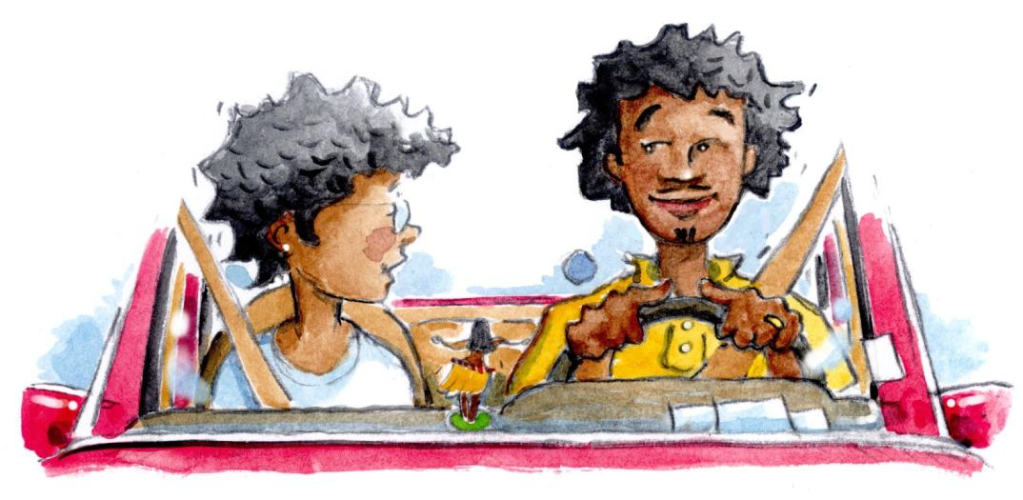
Getting Our
Hearts Right
BIAS IN ACTION
You know, you have faults, too!
Yes. But they don’t bother me like yours do!
Notes:
[p.4]
A story of a couple—two good and hard-working people—illustrates the problem of bias. Occasionally the husband got irritated and complained about his wife’s faults. Finally she got tired of being criticized and declared, "You know, you have faults, too!" The husband replied, "Yes. But they don't bother me like yours do!"

Slide 17
Getting Our
Hearts Right
The soundtracks of our lives.
Notes:
The soundtracks of our lives (Dueling soundtracks)
We all have our own music playing so loudly that it is hard for us to hear anyone else’s music! Our lives our poorer when we do not listen to other people’s music.
How do we pause our music so we can hear others’ music?

Slide 18
Getting Our
Hearts Right
We process our perceptions through our own life stories.
Notes:
We process our perceptions through our own life stories
Les Mis example – Given Jean Valjean’s experience of being imprisoned for 19 years for stealing a loaf of bread to feed his family, he did not initially understand how the priest could extend compassion to him when he was caught stealing the priest’s silver.
Also, Javert (the policeman who relentlessly pursued Jean Valjean and was cruel to him) did not understand how Jean Valjean could spare his life, and show him compassion, when Jean Valjean had the opportunity to kill him.
Another example: It’s a Wonderful Life – George Bailey thought his life was not worth much until he was able to see how the lives of people he cared about turned out without him. It would be nice if we could all have an “It’s a Wonderful Life” type experience. It would help us to see things differently – through the lens of other people’s life stories.

Slide 19
Getting Our
Hearts Right
The solution to bias goes beyond knowledge and skills.
Notes:
The solution to bias goes beyond knowledge and skills: Getting our hearts right
Steven Covey tells the story (1997, p. 205) of his wife, Sandra’s, irrational attachment to Frigidaire appliances. They were discussing purchasing a new appliance and she insisted upon a Frigidaire even though he felt another model would better meet their needs. She seemed unwilling to consider his reasons for wanting to buy another brand. This unwillingness to acknowledge his preferences began to frustrate him. Finally they were able to spend some peaceful time together and his wife opened up about her feelings. As a young girl, Sandra’s father operated an appliance store. During a time when the store experienced great economic difficulties, Frigidaire was the only company willing to finance her father’s inventory which enabled him to stay in business. Since Frigidaire had been loyal to her family and saved their business, she felt a strong desire to be loyal to that brand. Understanding the feelings behind her position allowed her husband to replace his sense of frustration with empathy. He could finally see that her attachment to Frigidaire was not irrational or intended as disrespectful towards his preferences. He could accept her loyalty to that brand. (The 7 Habits of Highly Effective People)
Let’s talk about the three keys to getting our hearts right.

Slide 20
Getting Our
Hearts Right
Key 1:
Humility opens our hearts.
Notes:
[p.4]
Key 1: Humility opens our hearts.
Covey on subway story – Sunday morning on NYC subway. It was quiet and there were few riders. Man gets on with young children who are loud and disruptive. Covey’s irritation and anger grow towards the father who does nothing to control his kids. Covey approaches father and tells him how disruptive his kids are being. Father apologizes and says, “I’m sorry. We just came from the hospital where there mother passed away. I guess we don’t quite know how to handle it.” Instantly, Covey’s irritation disappears. He finds himself asking how he might be of help to this father and his children. The father’s story touched Covey and humbled him. It opened his heart.
Abe Lincoln and Mary Todd Lincoln story – Lincoln was outside talking to a Congressman about the important political matters of the day when his wife, Mary Todd Lincoln, stormed out of the house, ruthlessly castigated Lincoln for something he had done, and then stormed back inside. Aghast that a wife would behave so outrageously in public, the Congressman looked to see Lincoln’s reaction. Lincoln was undisturbed by the incident and explained to the incredulous congressman that such outbursts made his wife feel so much better that he hardly wanted to put a stop to them. (Christensen & Jacobson, p. 131)
Sometimes being knocked down by life helps us understand other people’s pain (i.e., We may think someone with a particular health problem is a whiner, until we experience that same problem ourselves. Then we begin to understand in a different way what they were going through.)
How do you react when someone attacks you?
Usual response: “Look who’s talking! The village idiot!” vs.
Humble response: “I’m sure you know things that I could learn from.”

Slide 21
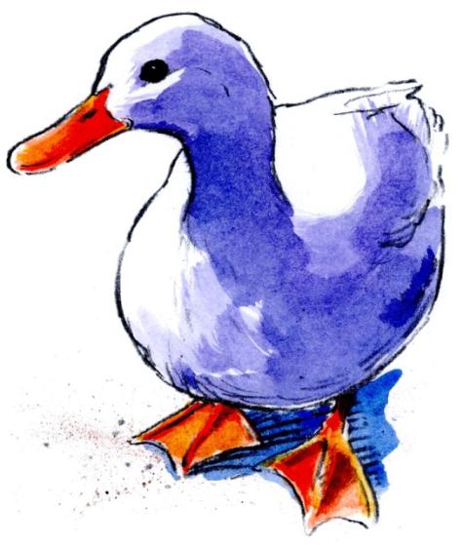
Getting Our
Hearts Right
How to cultivate humility
Notes:
[p.5]
How to cultivate humility
Story of the ducks
Nancy and Wally were sitting by the side of a small lake feeding ducks. A little boy came along who was fascinated by the ducks. He ran toward them which made the ducks squawk and run. I turned to the boy threateningly: “Do not chase the ducks.” My wife nudged me. “Maybe he would like to feed them.” I immediately recognized my hard-heartedness. I asked the boy: “Would you like to feed the ducks?” He was delighted. So I taught him to stand quietly in front of me and throw the food to the ducks. The ducks gathered around us again and the boy was thrilled. Nancy’s comment helped me recognize my own bias. I had been so absorbed in my own needs that I had failed to see a little boy who just wanted to play with the ducks. The boy was not following my rules for living. I had the spirit of correction rather than humble helping.

Slide 22
Getting Our
Hearts Right
Reflection:
How can you activate humility in your life and relationships?
Notes:
How can you activate humility in your life and relationships? Your answers? What do you think? (No wrong answers)
Discussion
Be thinking about a conflict in your life and how this applies. Write down that conflict in the first box on p. 5.

Slide 23
Getting Our
Hearts Right
Science’s two-part answer for activating humility:
Notes:
Science’s two-part answer for activating humility:

Slide 24
Getting Our
Hearts Right
Science’s two-part answer for activating humility:
1. Consider your biases.
Notes:
Consider your biases
Study the list of biases. Be humbled by the reality of our limited vision. In the reflection box at the bottom of p. 5, write down your thoughts.
----Irritation is an invitation—to new kinds of thinking and feeling.
Carol Lynn Pearson told a story that illustrates the power of humility (New Era, March 1984):
I can remember many occasions when my perception has crumbled and a glimpse inside has wiped away judgment. During my college years I looked at a fellow student, whom I will call Roy, in amazement. Where did he get such a gigantic ego? His need to be recognized and praised was never ending. Every conversation he had with anyone always centered on his recent triumphs and the projects he was now involved in that would ensure his fame. He was underappreciated and let everyone know it. His name became a joke. We had him pegged as an obnoxious egomaniac who blew his own horn from morning until night.
One day I learned that one of my friends knew his family. She began to tell me some things. "Roy's father was an alcoholic. Did you know that?"
"No, I didn't."
"Oh, yes. He made their life just miserable. He was a crazy man. Once, when Roy was about five he walked in the kitchen and saw his father attempting to kill his mother. It was a terrible scene and Roy was there to watch it all."
The tremor was instant. All my perceptions, all my judgment shattered, and I saw past the facade in the reality. I saw past the obnoxious adult to the traumatized little boy that I wanted to take in my arms and comfort. I never looked at Roy the same again. I knew his secret, one of his secrets, and I understood.

Slide 25
Getting Our
Hearts Right
Science’s two-part answer for activating humility:
1. Consider your biases.
2. Consider the weakness in your position.
Notes:
[p. 6]
Consider the weakness in your position
Tavris & Aronson (2007) – In their book Mistakes were made (but not by me) – “When confidence and convictions are unleavened by humility, by an acceptance of fallibility, people can easily cross the line from healthy self-assurance to arrogance.” (p. 228)
Dishwasher loading – a source of marital conflict – James grew up loading silverware in dishwasher with the point up. He assumed that was the “right” way because that’s how his family did it – and surly the silverware got cleaner that way as well. His wife, Kathie, grew up loading silverware in the dishwasher with the points down. For her it was a safety issue. James agreed that safety was important, plus he had no real evidence the silverware got cleaner with the points up. He agreed to load points down and ever since then they have been a “points down” family.
Jonathan Haidt’s (2006) conclusion from his book The happiness hypothesis is, “A good place to look for wisdom, therefore, is where you least expect to find it: in the minds of your opponents. You already know the ideas common to your own side. If you can take off the blinders of the myth of [bad intent], you might see some good ideas for the first time.” (p. 242)
Be willing to consider the weakness in your position in each of the following areas: politics, religion, work, family life, etc. It might help you see things you’ve never seen before.
Can you think of a time when you were humble enough to see the weakness in your position/thinking? Did it change you in some way? Write your thought in the reflection box on p. 6.

Slide 26
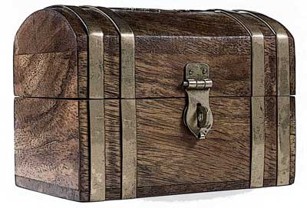
Getting Our
Hearts Right
Applying humility to your own situation
Notes:
Applying humility to your own situation
Box—hard to get stuff into the box when it is closed and locked.
It is hard to get new perceptions into our minds and new attitudes into our hearts when they are locked tight.
Remember the two keys steps to opening our hearts:
Consider our own bias.
Consider the weakness in our own position.
How do you activate humility? Write down your thoughts on p. 6.

Slide 27
Getting Our
Hearts Right
Key 2:
Compassion connects our hearts.
Notes:
[p. 6]
Key 2: Compassion connects our hearts.
The meaning of compassion: feeling what someone else is feeling—and wanting to help – being sensitive to the struggles and suffering of others
The well-known story of the Good Samaritan is an excellent example of compassion. The Samaritan stopping to help the Jewish man who had been robbed, beaten, and left for dead is the modern-day equivalent of a member of Al Queda stopping to help an American.
Example: High school basketball player who saved a young man in a wheelchair who was being crushed by an excited crowd during a post game celebration on the court.
Compassion is a choice of the heart. We’re not just victims of our feelings.
How do you feel when your rival or opponent has bad luck?
Usual response: “Serves em’ right!” “She got what she deserves.” vs.
Compassionate response: “Ouch! That’s too bad.”

Slide 28
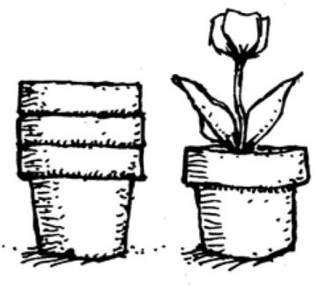
Getting Our
Hearts Right
How to cultivate compassion
Notes:
[p. 7]
How to cultivate compassion
Hannah and Emily:
On their way to the playground, Hannah and Emily needed to cross a street. When they got to the crosswalk, Emily stopped and Hannah ran into the street where she was hit by a passing car. Fortunately the car was traveling slowly but she still lay in the road with painful scrapes. What should we do? Hannah had acted foolishly. Maybe we should give her a lecture about looking before crossing streets. Maybe we should put her in time-out. Those heartless responses lack compassion. The right response—the compassionate response—is to do everything we can to comfort Hannah and get her healing started. It does not matter that she was foolish; when people are hurting, we show them compassion.
Compassion is not about deservingness but about need.
One of the great ironies of compassion is that we are born with natural compassion—but we learn to be very selective in offering it saving it for friends and family—for the “us-es” not the “thems”.

Slide 29
Getting Our
Hearts Right
Stay peaceful.
How to cultivate compassion
Notes:
Stay peaceful. – For example, I can be annoyed and critical when I come home to a messy house or I can jump in and help.
Don’t dwell on distress.
Declare peace rather than war. Taking time-outs to cool down is okay.
What are some ways we react poorly when we are in conflict? (criticism, contempt, defensiveness, withdrawal)
How can we avoid these behaviors and stay peaceful? Record your thoughts in the reflection box on p. 7.

Slide 30
Getting Our
Hearts Right
Stay peaceful.
Recognize that your perceptions are not the whole story.
How to cultivate compassion
Notes:
Recognize that your perceptions are not the whole story.
People do what they do for reasons that make sense to them. When their actions don’t make sense to us, it is because we don’t understand them.
We tend to hear only our own music. We have no idea what tune is playing on their iPod.
Record your thoughts in the reflection box on p. 7.

Slide 31
Getting Our
Hearts Right
Stay peaceful.
Recognize that your perceptions are not the whole story.
How to cultivate compassion
Listen to and understand the feelings of others.
Notes:
[p. 8]
Listen to and understand the motives and feelings of others.
Story - Honey, I’m Home
Jenny had gotten home from work late and looked at the clock. Ouch. Her husband would be there any minute. He was a long-distance truck driver who was gone 3-4 days at a time. He was due back from his latest trip at 6:00 pm or so, and her tradition was to celebrate the beginning of several days together with a special dinner. She loved doing it. She would even light candles and use their only linen tablecloth.
But now she had only 15 minutes to start a meal and get everything else ready. At 6:15 pm she actually was relieved he still had not arrived. It gave her the chance to get the food going. Nevertheless, all too soon she heard the air brakes bleat as he brought the 18-wheeler to a stop in front of the house. She began biting her lip. She could imagine him taking off his boots in the utility room, hanging up his coat and calling out to her. She knew his face would fall when he saw the half-set table and no food.
The door opened, the boots were unlaced, and the coat was hung up. He called out: “Hey, Jenny.” She automatically yelled back, “Hi, Hon.” She inhaled in anticipation of his disappointed look as he glanced around the corner into the kitchen. He looked at the table. He gazed up at her, broke into a big smile and bellowed, “Well, it looks like I got home just in time to help!” All her fears dissolved.
Compassion involves “turning towards” another person rather than “turning away from” or “against” them. In the story above, the truck driver “turned toward” his wife and it made all the difference. It clamed her fears.
Two important parts of “turning toward” others are: 1. Being willing to listen past the edge in their voice and 2. responding to their hopes and dreams for the future (granting in fantasy that which you can’t grant in reality).

Slide 32
Getting Our
Hearts Right
Applying compassion to your own situation
How can you open your heart to someone else’s view?
Notes:
Applying compassion to your own situation
The helpful traveler story:
Setting: Chicago airport, bad weather and canceled flights had stranded many hungry, tired travelers.
Subject: Woman with a tired crying, soaked, 2-year-old was pushing her along with her foot as they waited in line to be re-booked.
The perspective of observers: Critical of insensitive mother, annoyed by crying child, no one offered to help child or mother. “She didn’t deserve their help.”
One who was different: Older man with a kind smile asked: “May I help?” He lifted the sobbing child and held her. He offered her a piece of gum. The mother told him that she was pregnant and threatening to miscarry and had been told by her doctor not to carry the child. The man then talked to the people in the line one by one telling them that the mother needed their help and asking if they would allow the woman to go to the front of the line. He took her to the counter and got her the next flight to Michigan. He walked mother and daughter to seats at their gate, made sure they were okay, then parted.
Notice how judging a person keeps us from feeling or showing compassion. When we focus on the pain, we know what to do.
Discussion: How can you open your heart to someone else’s view? Record your thoughts in the reflection box on p. 8.

Slide 33
Getting Our
Hearts Right
Key 3:
Positivity inspires our hearts.
Notes:
[p. 9]
Key 3: Positivity inspires our hearts. It’s the practice of seeing the good in people.
Positivity may be one of the best attested truths of healthy relationships!
Sandra Murray and positive illusions – “Don’t dwell on negativity. Let positivity define your relationships. People who are the happiest have positive illusions about one another. They believe that their relationships are extraordinary. They see through rose-colored glasses.”
Research indicates healthy relationships are more idealistic and realistic.
John Gottman and 5:1 ratio of positive comments and interactions for every one negative. He also recommends writing down the things that “went well” on a daily basis.
Albert Einstein – “Everybody is a genius. But if you judge a fish by its ability to climb a tree, it will live its whole life believing that it is stupid.”
As you interact with people what do you usually see/think?
Usual response: “People are a mess. They are self-centered and thoughtless.” (John Gottman calls this practicing a “crabby habit of mind.”)
Positive response: “People really try. I’m amazed at some of the things they come up with.”

Slide 34
Getting Our
Hearts Right
How to cultivate positivity.
Notes:
How to cultivate positivity
50 wedding anniversary
At their 50th wedding anniversary, friends asked the honored couple the secret to their happiness. The wife replied that, when they first got married, she decided to forgive her husband ten of his faults. The curious guests asked her to name some of the faults. She replied that she never got around to listing the faults—but every time he did something that made her mad, she told herself: “It’s a good thing for him that is one of the ten!”
For healthy relationships, we can offer people pre-forgiveness. Even before they have annoyed or hurt us, we already choose to forgive them.

Slide 35
Getting Our
Hearts Right
How to cultivate positivity.
We can remember the good times in a relationship.
Notes:
We can remember the good times in a relationship.
Think of the conflict you described earlier. What are your best memories of that person? Write those memories in the reflection box on p. 9.
Married couple: When we are upset with one another, we are better off remembering all the things we love about one another and the good times we’ve had (i.e. trips, anniversaries, inside jokes, shared interests, passion, enthusiasm, humor, smile, etc.)

Slide 36
Getting Our
Hearts Right
How to cultivate positivity.
We can remember the good times in a relationship.
We can focus on the good qualities in people and appreciate how they enrich our lives.
Notes:
[p. 10]
We can focus on the good qualities in people and appreciate how they enrich our lives.
In the first reflection box on p. 10, write the good qualities the person has.
Story - Teen girl who’s driving with the family in the car. She lets go of wheel on a long curve that scares her. They crash through a Penzoil sign and come to a screeching stop in front of a gas station. After a moment of silence, the father quips, “As long as we are here, does anyone need to use the restroom?”

Slide 37
Getting Our
Hearts Right
How to cultivate positivity.
We can remember the good times in a relationship.
We can focus on the good qualities in people and appreciate how they enrich our lives.
When relationships don’t go well, we can assume that problems are temporary or minimal.
Notes:
When relationships don’t go well, we can assume that problems are temporary or minimal.
Whatever the problem – This too shall pass. It may pass like a kidney stone, but it will pass.
Positive way of thinking in marriage – I don’t know or see the solution right now, but I love you and am committed to you so I know we will find a solution.
We can ask, “What temporary circumstances may be contributing to the conflict?” (i.e., rough day, bad mood, misunderstanding, hungry, sleepy, etc.)
In the reflection box on p. 10, write the ways you can “re-script” your memories of the relationship.

Slide 38
Getting Our
Hearts Right
How to cultivate positivity.

Slide 39
Getting Our
Hearts Right
How to cultivate positivity.
We can see the good things in our relationships as enduring and typical.
Notes:
We can see the good things in our relationships as enduring and typical.
We can make a choice to see in positive ways. That expands our hearts from puny to powerful.
Gottman: wearing rose-colored glasses so that we see the best in others.
Think about the things that have helped the relationship flourish during times when it was at its best and record those in the reflection box on p. 10.

Slide 40
Getting Our
Hearts Right
How to cultivate positivity.
We can see the good things in our relationships as enduring and typical.
We can identify examples of people who sustain positive relationships and learn from their examples.
Notes:
We can identify examples of people who sustain positive relationships and learn from their examples.
Someone you know? Who is a great example of sustaining positive relationships? What can you learn from them?
Record this in the reflection box on p. 10.

Slide 41
Getting Our
Hearts Right
Applying positivity to your own situation
What has helped you be more positive in your relationships?
Notes:
Applying positivity to your own situation
What has helped you be more positive in your relationships?
Maybe your religious convictions? (love your enemies, do good to them who hate you, bless them that curse you . . .)
A loving example? (a leader or school teacher or neighbor . . .
Discussion

Slide 42
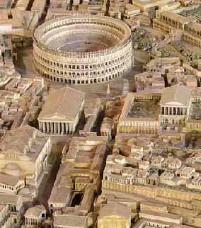
Getting Our
Hearts Right
Changed hearts activate loving responses—but it often takes effort over time to get our hearts right.
Notes:
[p. 11]
Changed hearts activate loving responses.
Rome wasn’t built in a day – It required conscious effort and enduring commitment
Think, feel, and act in different ways. Develop new habits.
We can learn to be more open to other people (humble), more sensitive to their concerns (compassionate), and more appreciative of their efforts (positive).

Slide 43
Getting Our
Hearts Right
Conclusion:
Knowledge + Skills + Right Heart =
Better Relationships
Notes:
It takes more than just knowledge and skills to have better relationships. But those combined with the motivation of a right heart will help us have the thriving relationships we want.

Slide 44
Getting Our
Hearts Right
Three Keys to
Better Relationships
Notes:
References (See also Recommended Reading on p. 12 of the workbook.)
Baumeister, R. (1991). Meanings of life. New York: Guilford Press. Frederick Buechner, Wishful Thinking (San Francisco: Harper & Row, 1993), 2.
Gardner, D. (2008). The science of fear: Why we fear the things we shouldn’t—and put ourselves in greater danger. New York: Dutton.
Haidt, J. (2006). The happiness hypothesis. New York: Basic Books.
Pearson (1984). New Era magazine.
Peters, L. J. (1977). Peter's quotations: Ideas for our time. New York: Bantam. Sigsgaard, E. (2005). Scolding: Why it hurts more than it helps. New York: Teachers College Press.
Tavris, C., & Aronson, E. (2007). Mistakes were made (but not by me). New York: Harcourt, Inc.
Williams, R., & Williams, V. (1993). Anger kills: Seventeen strategies for controlling the hostility that can harm your health. New York: Times Books.

